Slide 1
ECON 645: Week 1
Introduction, Omitted Variable Bias, Misspecification, Endogeneity
*Views do not represent HRSA or HHS

Slide 2
Overview for Week 1
Introduction
Expected Value and Variance of OLS Estimator
Endogeneity
Omitted Variable Bias
Misspecification
Measurement Error
Simultaneity
Missing Data
Biased Standard Errors
Overidentification
Multicollinearity
Heteroskedasticity
Measurement Error Data

Slide 3
Introduction to ECON 645
Build off of ECON 644
Dealing with endogeneity
Using Instrumental Variables
Using Panel Data
Limited Dependent Variables
Logit, Probit, and Tobit
Poisson/Negative Binominal
Censored and Truncated
Sample Selection
Time Series
Stationary and Weakly Dependence
Highly Persistent Time Series
Serial Correlation

Slide 4
Week 1 Overview
Expected Value and Variance of OLS Estimators
Gauss-Markov Assumptions
Unbiasedness, Consistency, and Efficiency
Biased Coefficients
Endogeneity and Endogenous Explanatory Variables
Omitted Variable Bias
Misspecification
Measurement Error
Missing Data on Independent Variables
Simultaneity
Biased Standard Errors
Multicollinearity
Heteroskedasticity
Missing Data on Dependent Variables

Slide 5
Expected Value of the OLS Estimator
Brief Review

Slide 6
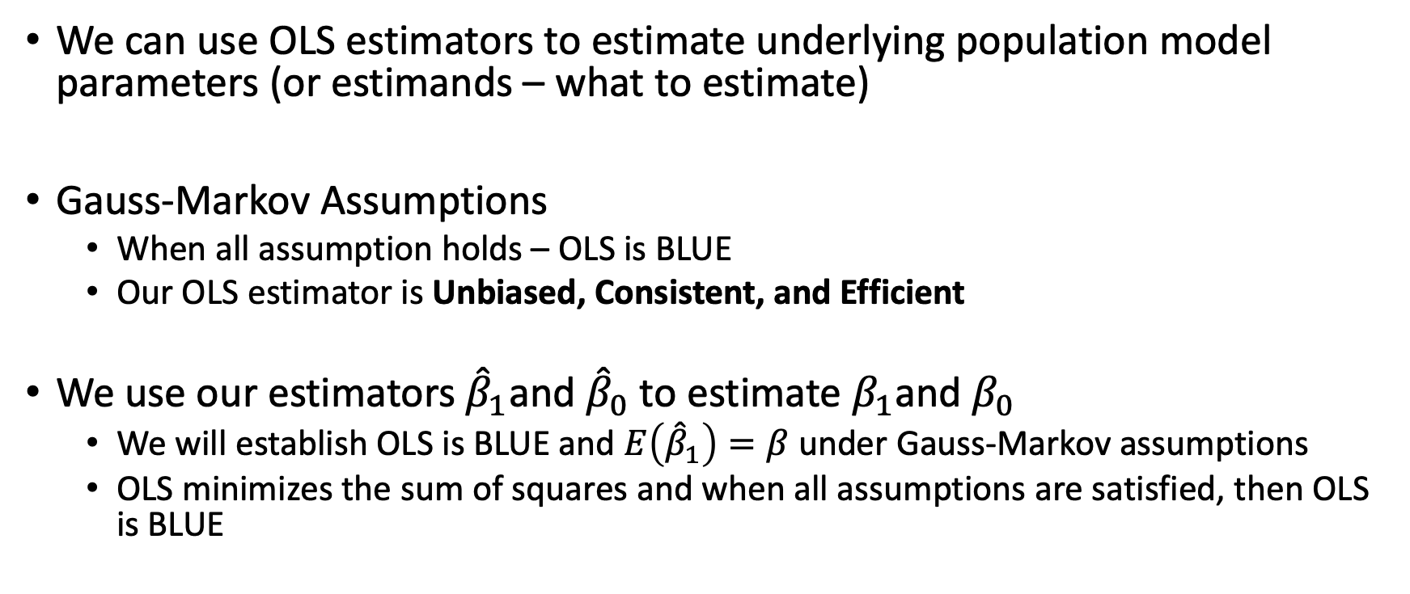
Expected Value of OLS Estimators
We can use OLS estimators to estimate underlying population model parameters (or estimands – what to estimate)
Gauss-Markov Assumptions
When all assumption holds – OLS is BLUE
Our OLS estimator is Unbiased, Consistent, and Efficient
We use our estimators ${\hat{β}}_{1}$and ${\hat{β}}_{0}$ to estimate $β_{1}$and $β_{0}$
We will establish OLS is BLUE and $E\left({\hat{β}}_{1}\right)=β$ under Gauss-Markov assumptions
OLS minimizes the sum of squares and when all assumptions are satisfied, then OLS is BLUE

Slide 7
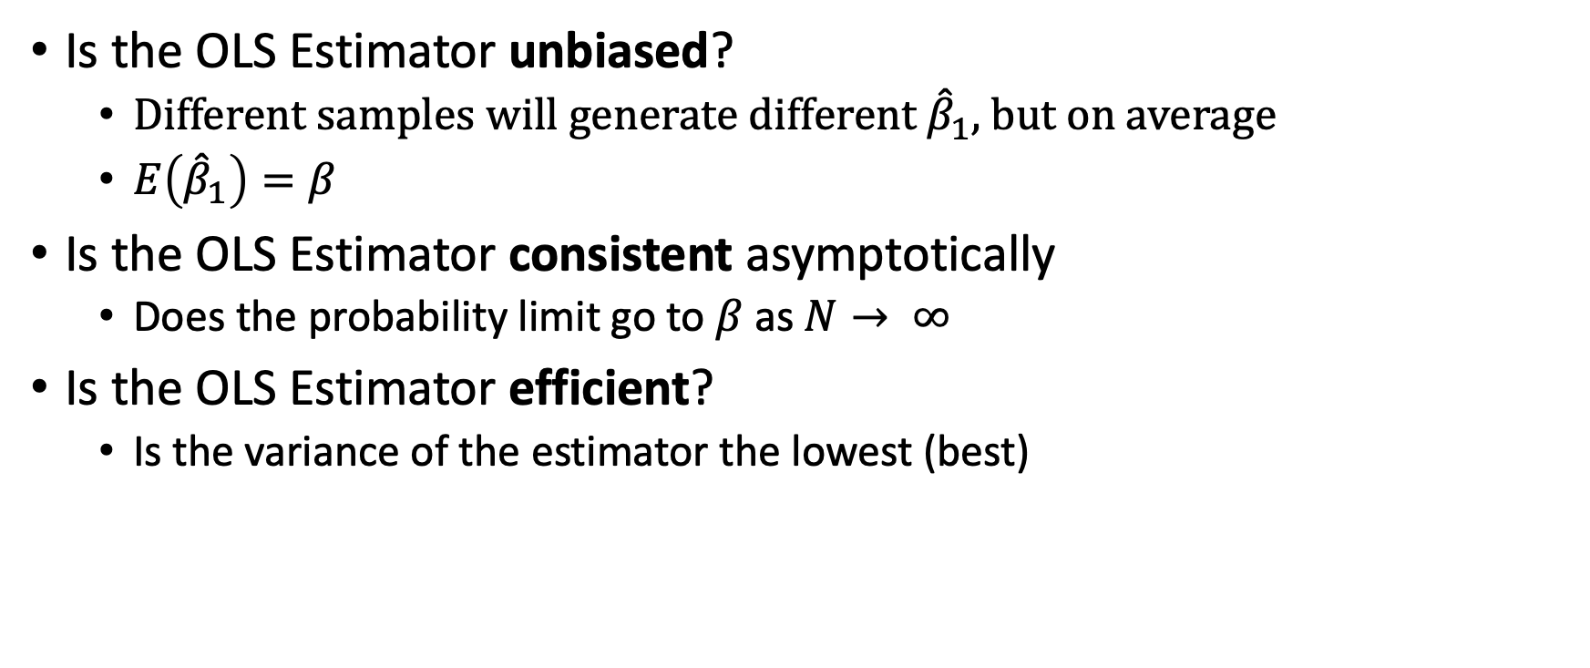
Expected Value of OLS
Is the OLS Estimator unbiased?
Different samples will generate different ${\hat{β}}_{1}$, but on average
$E\left({\hat{β}}_{1}\right)=β$
Is the OLS Estimator consistent asymptotically
Does the probability limit go to $β$ as $N→ ∞$
Is the OLS Estimator efficient?
Is the variance of the estimator the lowest (best)

Slide 8
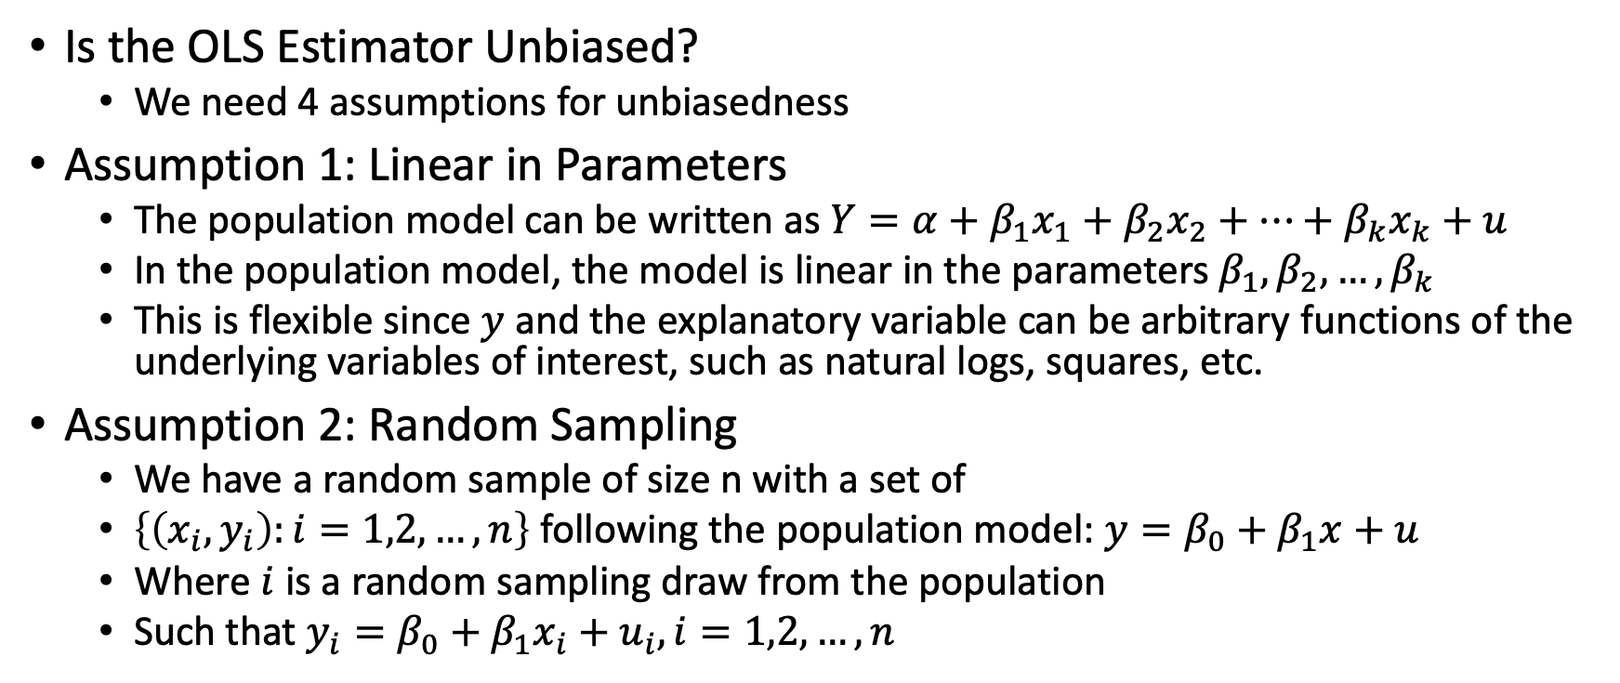
Gauss-Markov Assumptions
Is the OLS Estimator Unbiased?
We need 4 assumptions for unbiasedness
Assumption 1: Linear in Parameters
The population model can be written as $Y=α+β_{1}x_{1}+β_{2}x_{2}+…+β_{k}x_{k}+u$
In the population model, the model is linear in the parameters $β_{1}, β_{2},…, β_{k}$
This is flexible since $y$ and the explanatory variable can be arbitrary functions of the underlying variables of interest, such as natural logs, squares, etc.
Assumption 2: Random Sampling
We have a random sample of size n with a set of
$\left\{\left(x_{i},y_{i}\right):i=1,2,…,n\right\}$ following the population model: $y=β_{0}+β_{1}x+u$
Where $i$ is a random sampling draw from the population
Such that $y_{i}=β_{0}+β_{1}x_{i}+u_{i}, i=1,2,…,n$

Slide 9
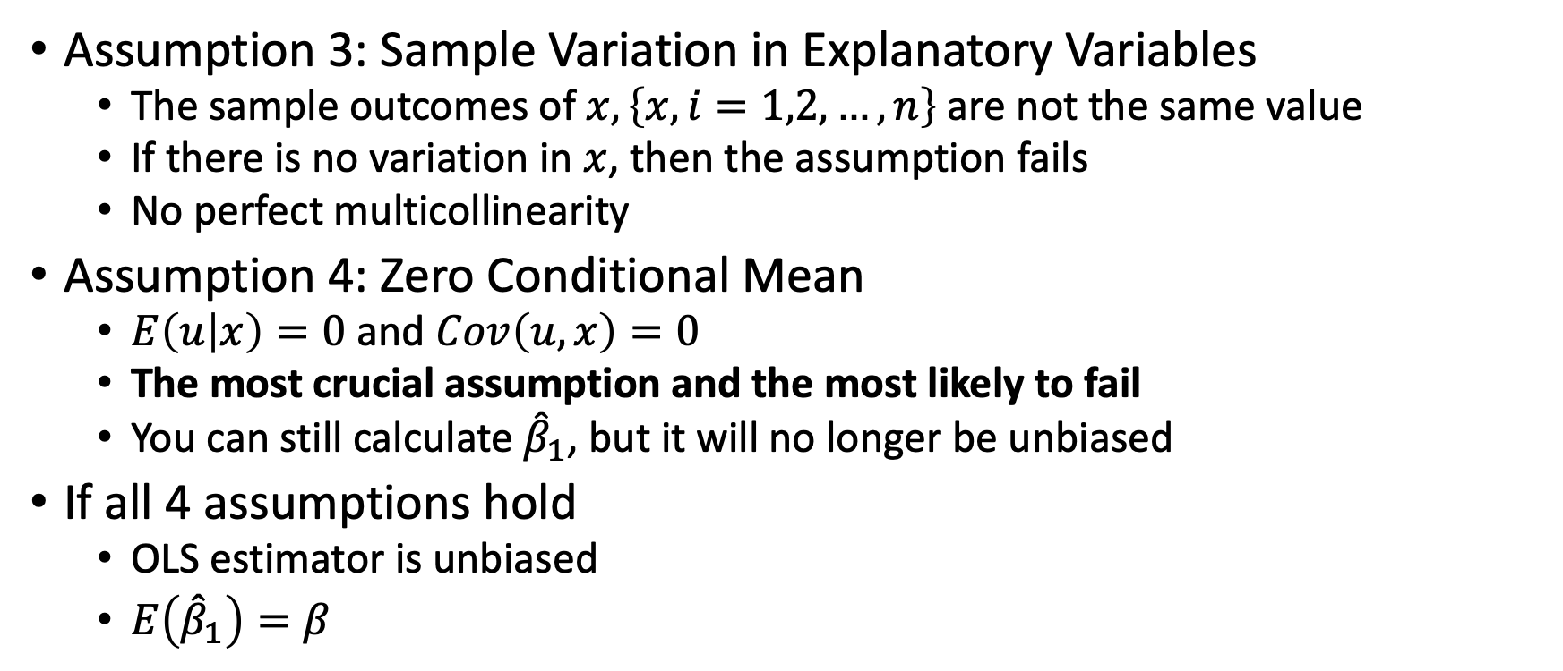
Gauss-Markov Assumptions
Assumption 3: Sample Variation in Explanatory Variables
The sample outcomes of $x, \left\{x, i=1,2,…,n\right\}$ are not the same value
If there is no variation in $x$, then the assumption fails
No perfect multicollinearity
Assumption 4: Zero Conditional Mean
$E\left(u | x\right)=0$ and $Cov\left(u,x\right)=0$
The most crucial assumption and the most likely to fail
You can still calculate ${\hat{β}}_{1}$, but it will no longer be unbiased
If all 4 assumptions hold
OLS estimator is unbiased
$E\left({\hat{β}}_{1}\right)=β$

Slide 10
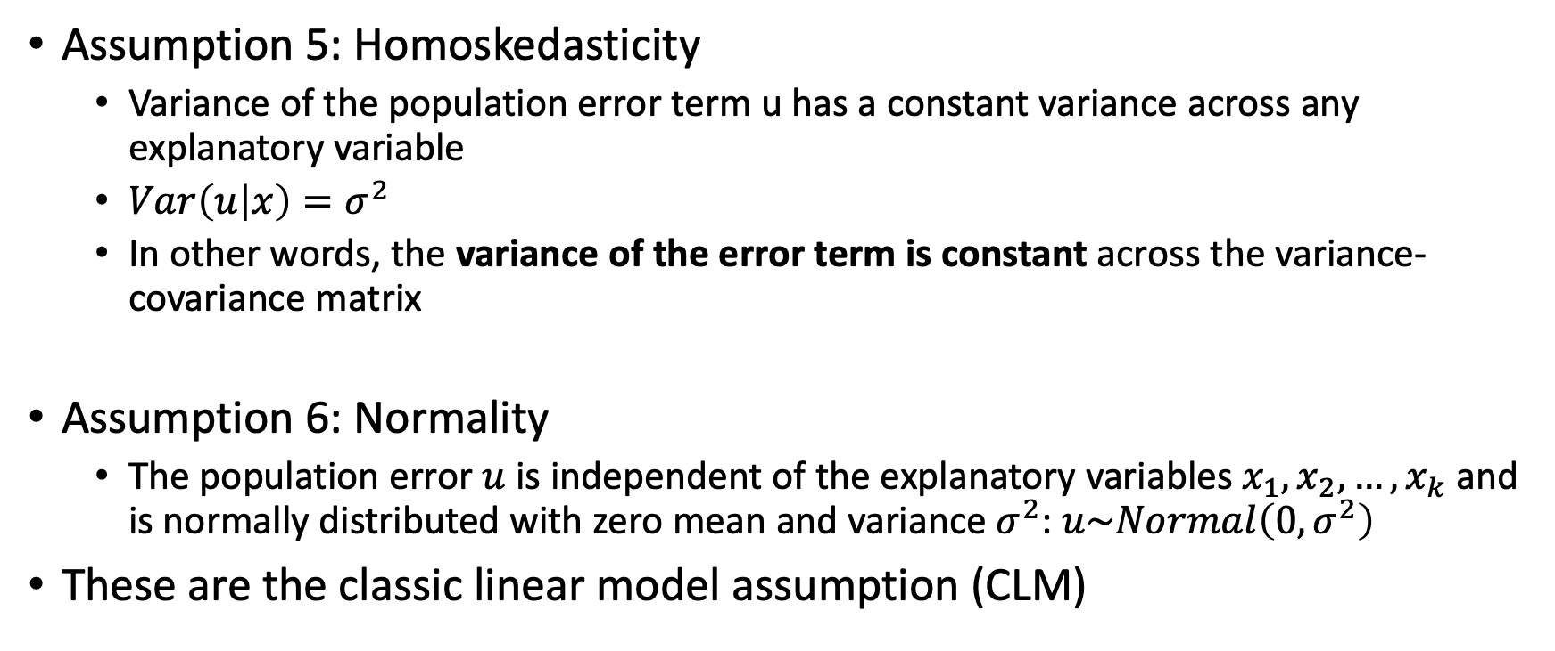
Gauss-Markov Assumptions
Assumption 5: Homoskedasticity
Variance of the population error term u has a constant variance across any explanatory variable
$Var\left(u | x\right)=σ^{2}$
In other words, the variance of the error term is constant across the variance-covariance matrix
Assumption 6: Normality
The population error $u$ is independent of the explanatory variables $x_{1},x_{2},…,x_{k}$ and is normally distributed with zero mean and variance $σ^{2}$: $u\sim Normal\left(0,σ^{2}\right)$
These are the classic linear model assumption (CLM)

Slide 11
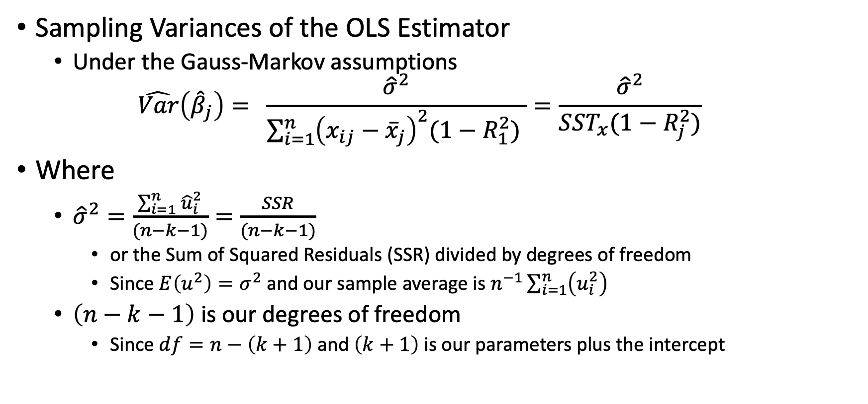
Variance of the OLS Estimator (part 1)
Sampling Variances of the OLS Estimator
Under the Gauss-Markov assumptions
$$\hat{Var}\left({\hat{β}}_{j}\right)= \frac{{\hat{σ}}^{2}}{\sum_{i=1}^{n}{{\left(x_{ij}−{\overline{x}}_{j}\right)}^{2}(1−R_{1}^{2}) }}=\frac{{\hat{σ}}^{2}}{SST_{x}(1−R_{j}^{2})}$$
Where
${\hat{σ}}^{2}=\frac{\sum_{i=1}^{n}{{\hat{u}}_{i}^{2}}}{(n−k−1)}=\frac{SSR}{(n−k−1)}$
or the Sum of Squared Residuals (SSR) divided by degrees of freedom
Since $E\left(u^{2}\right)=σ^{2}$ and our sample average is $n^{−1}\sum_{i=1}^{n}{\left(u_{i}^{2}\right)}$
$\left(n−k−1\right)$ is our degrees of freedom
Since $df=n−\left(k+1\right)$ and $\left(k+1\right)$ is our parameters plus the intercept

Slide 12
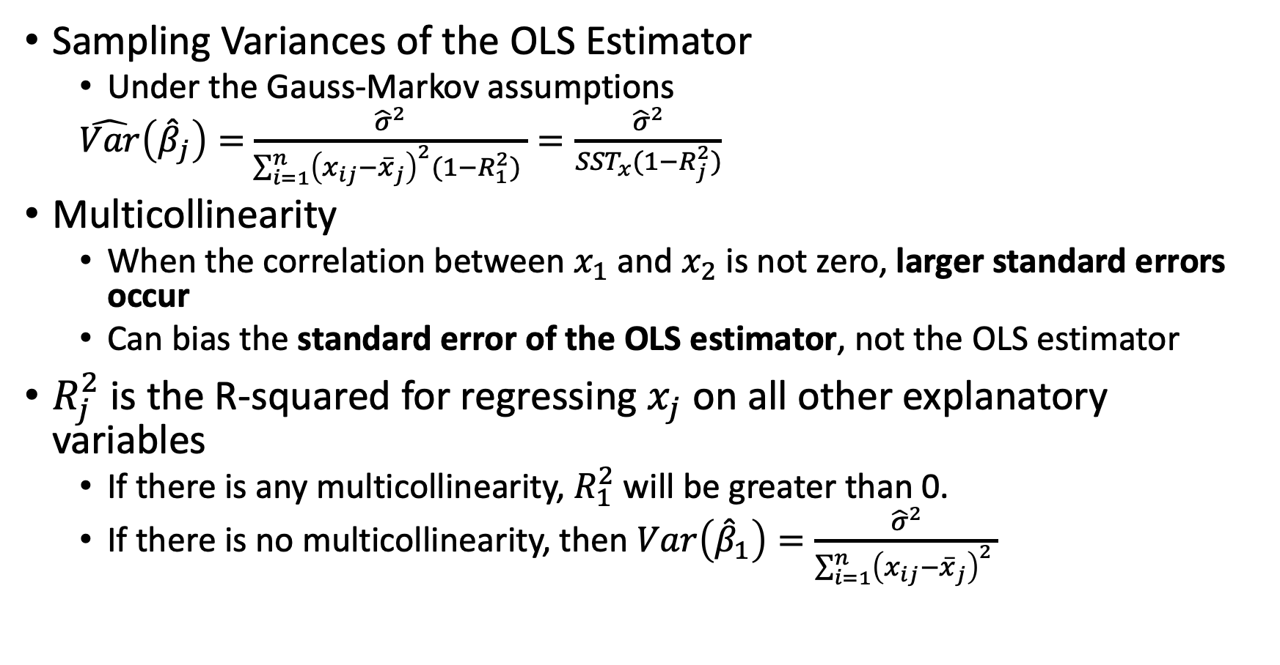
Variance of the OLS Estimator (part 2)
Sampling Variances of the OLS Estimator
Under the Gauss-Markov assumptions
$\hat{Var}\left({\hat{β}}_{j}\right)=$ $\frac{{\hat{σ}}^{2}}{\sum_{i=1}^{n}{{\left(x_{ij}−{\overline{x}}_{j}\right)}^{2}(1−R_{1}^{2}) }}=\frac{{\hat{σ}}^{2}}{SST_{x}(1−R_{j}^{2})}$
Multicollinearity
When the correlation between $x_{1}$ and $x_{2}$ is not zero, larger standard errors occur
Can bias the standard error of the OLS estimator, not the OLS estimator
$R_{j}^{2}$ is the R-squared for regressing $x_{j}$ on all other explanatory variables
If there is any multicollinearity, $R_{1}^{2}$ will be greater than 0.
If there is no multicollinearity, then $Var\left({\hat{β}}_{1}\right)=\frac{{\hat{σ}}^{2}}{\sum_{i=1}^{n}{{\left(x_{ij}−{\overline{x}}_{j}\right)}^{2} }}$

Slide 13
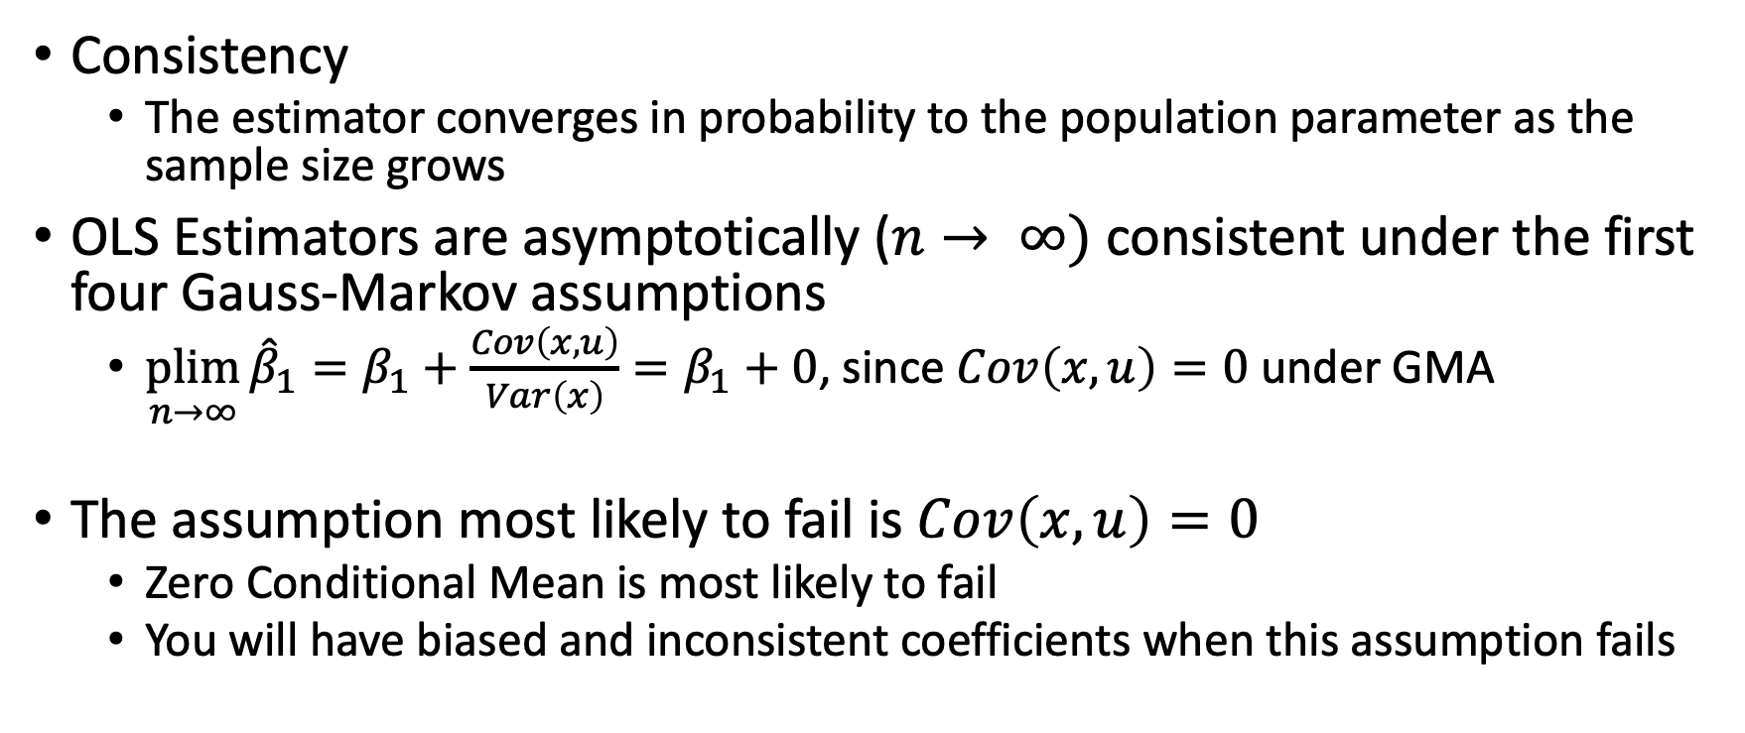
Consistent
Consistency
The estimator converges in probability to the population parameter as the sample size grows
OLS Estimators are asymptotically ($n→ ∞)$ consistent under the first four Gauss-Markov assumptions
$\underset{n→∞}{plim}{{\hat{β}}_{1}=β_{1}+\frac{Cov\left(x,u\right)}{Var\left(x\right)}=β_{1}+0}$, since $Cov\left(x,u\right)=0$ under GMA
The assumption most likely to fail is $Cov\left(x,u\right)=0$
Zero Conditional Mean is most likely to fail
You will have biased and inconsistent coefficients when this assumption fails

Slide 14
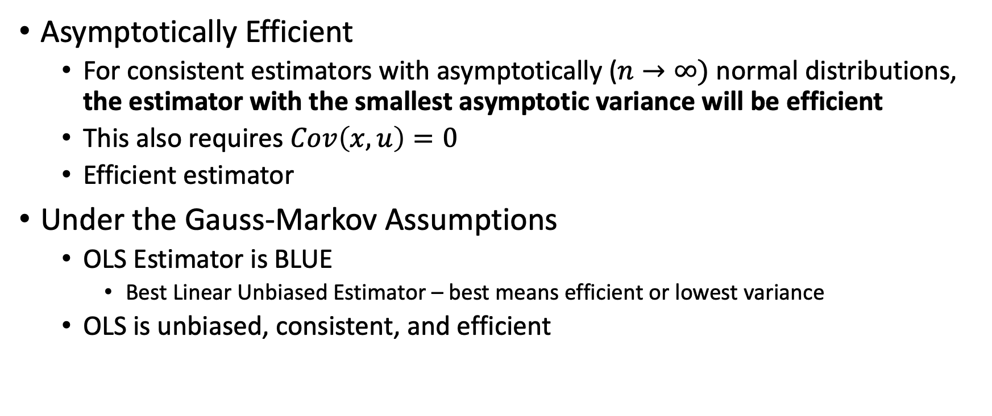
Efficient
Asymptotically Efficient
For consistent estimators with asymptotically ($n→∞)$ normal distributions, the estimator with the smallest asymptotic variance will be efficient
This also requires $Cov\left(x,u\right)=0$
Efficient estimator
Under the Gauss-Markov Assumptions
OLS Estimator is BLUE
Best Linear Unbiased Estimator – best means efficient or lowest variance
OLS is unbiased, consistent, and efficient

Slide 15
What can violate the different assumptions?
Linear in parameter assumption violated
We have specification errors - misspecification
Nonlinearity and the relationship between dependent and independent is not linear
No Perfect Collinearity assumption violated
Variables are allowed to be correlated, but they cannot be perfectly correlated
For example, if we have every group as a binary variable in our model and forget to omit one group, then we will have violated this assumption

Slide 16
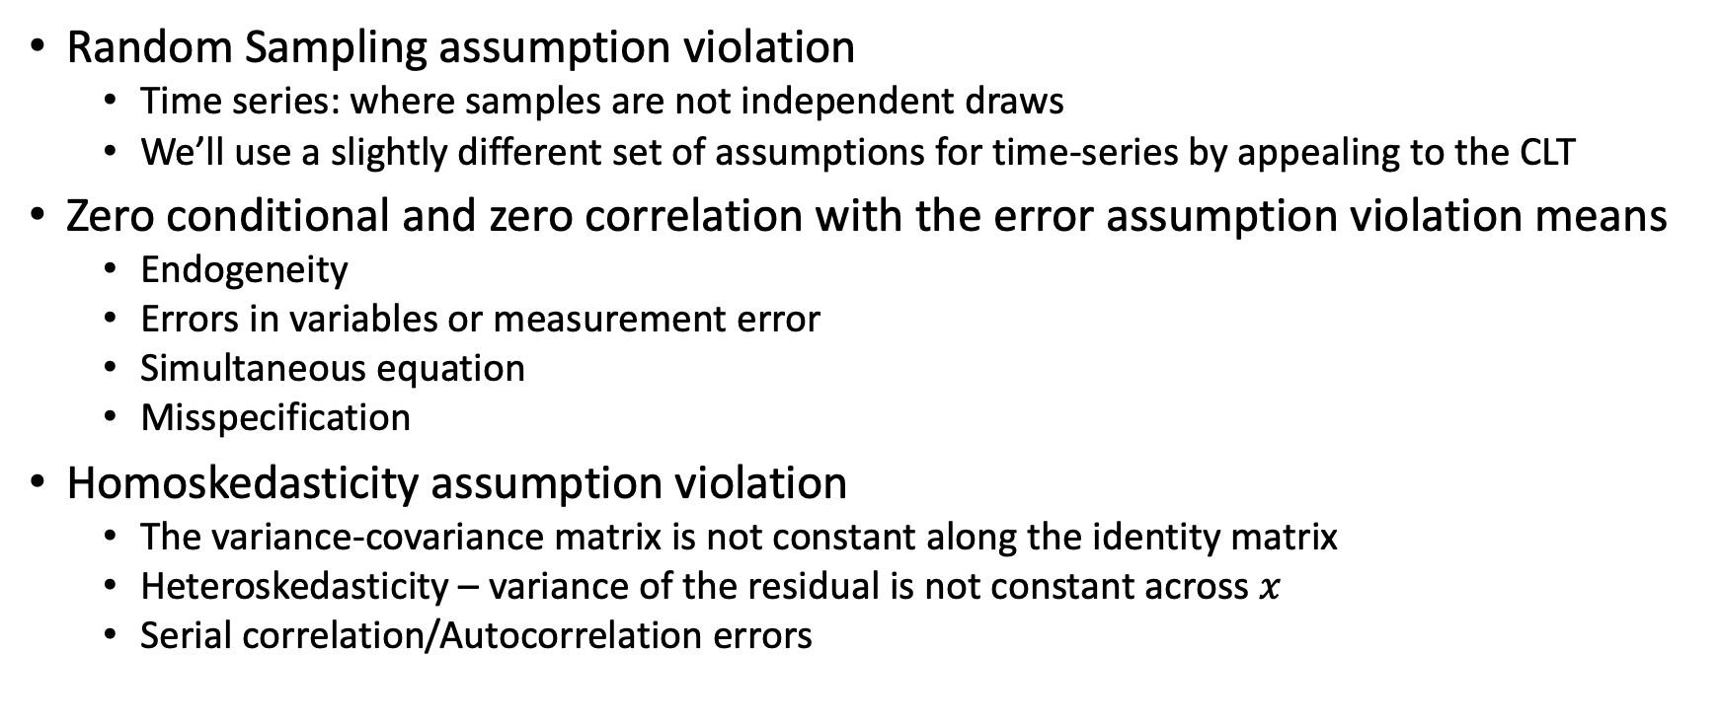
What can violate the different assumptions?
Random Sampling assumption violation
Time series: where samples are not independent draws
We’ll use a slightly different set of assumptions for time-series by appealing to the CLT
Zero conditional and zero correlation with the error assumption violation means
Endogeneity
Errors in variables or measurement error
Simultaneous equation
Misspecification
Homoskedasticity assumption violation
The variance-covariance matrix is not constant along the identity matrix
Heteroskedasticity – variance of the residual is not constant across $x$
Serial correlation/Autocorrelation errors

Slide 17
Endogeneity
What causes endogeneity?

Slide 18
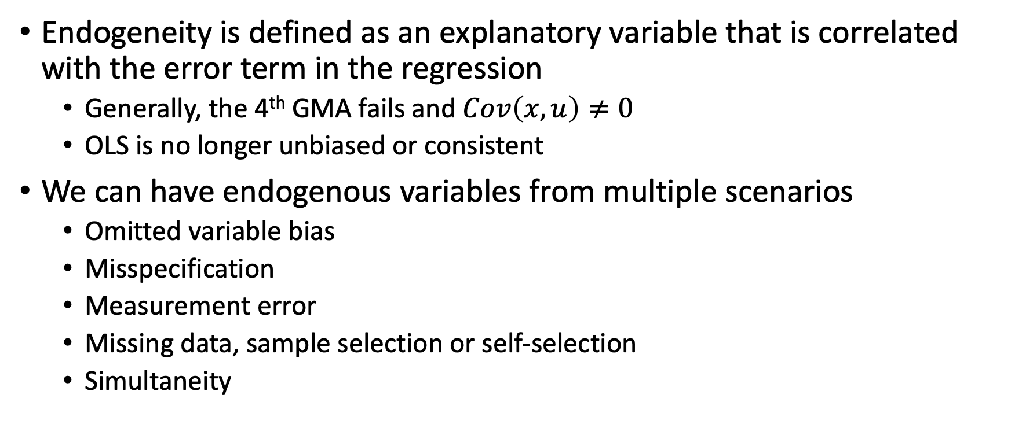
Overview of Endogeneity
Endogeneity is defined as an explanatory variable that is correlated with the error term in the regression
Generally, the 4th GMA fails and $Cov\left(x,u\right)≠0$
OLS is no longer unbiased or consistent
We can have endogenous variables from multiple scenarios
Omitted variable bias
Misspecification
Measurement error
Missing data, sample selection or self-selection
Simultaneity

Slide 19
Endogeneity: Omitted Variable Bias

Slide 20
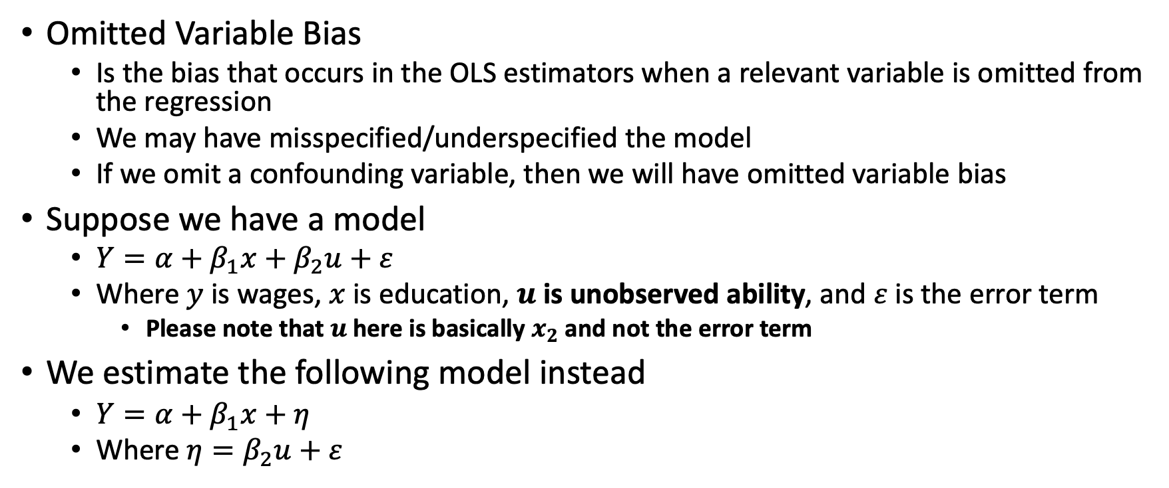
Omitted Variable Bias
Omitted Variable Bias
Is the bias that occurs in the OLS estimators when a relevant variable is omitted from the regression
We may have misspecified/underspecified the model
If we omit a confounding variable, then we will have omitted variable bias
Suppose we have a model
$Y=α+β_{1}x+β_{2}u+ε$
Where $y$ is wages, $x$ is education, $u$ is unobserved ability, and $ε$ is the error term
Please note that $u$ here is basically $x_{2}$ and not the error term
We estimate the following model instead
$Y=α+β_{1}x+η$
Where $η=β_{2}u+ε$

Slide 21
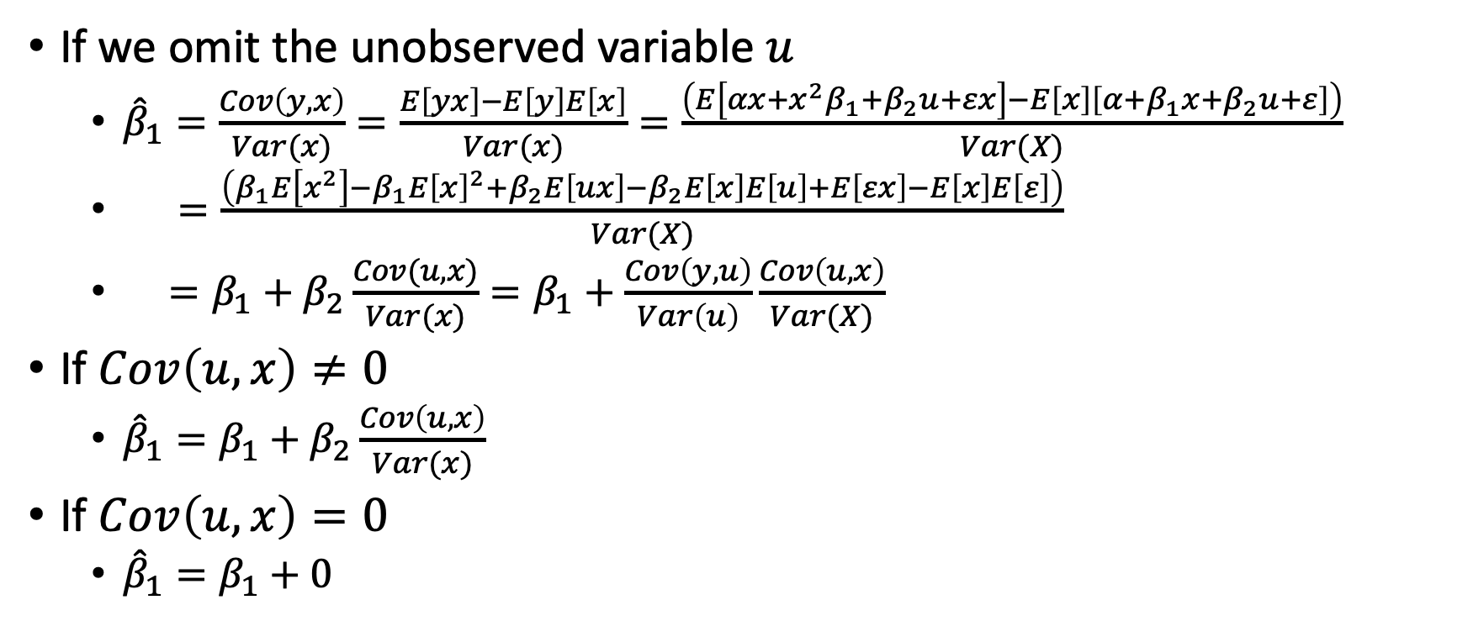
Omitted Variable Bias
If we omit the unobserved variable $u$
${\hat{β}}_{1}=\frac{Cov\left(y,x\right)}{Var(x)}=\frac{E\left[yx\right]−E\left[y\right]E\left[x\right]}{Var(x)}=\frac{\left(E\left[αx+x^{2}β_{1}+β_{2}u+εx\right]−E\left[x\right]\left[α+β_{1}x+β_{2}u+ε\right]\right)}{Var(X)}$
$=\frac{\left(β_{1}E\left[x^{2}\right]−β_{1}E{\left[x\right]}^{2}+β_{2}E\left[ux\right]−β_{2}E\left[x\right]E\left[u\right]+E\left[εx\right]−E\left[x\right]E\left[ε\right]\right)}{Var(X)}$
$=β_{1}+β_{2}\frac{Cov(u,x)}{Var(x)}=β_{1}+\frac{Cov\left(y,u\right)}{Var\left(u\right)}\frac{Cov\left(u,x\right)}{Var(X)}$
If $Cov\left(u,x\right)≠0$
${\hat{β}}_{1}=β_{1}+β_{2}\frac{Cov\left(u,x\right)}{Var(x)}$
If $Cov\left(u,x\right)=0$
${\hat{β}}_{1}=β_{1}+0$

Slide 22
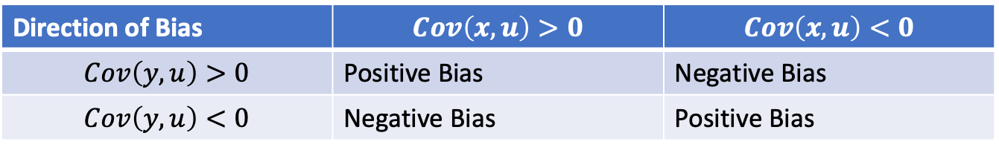
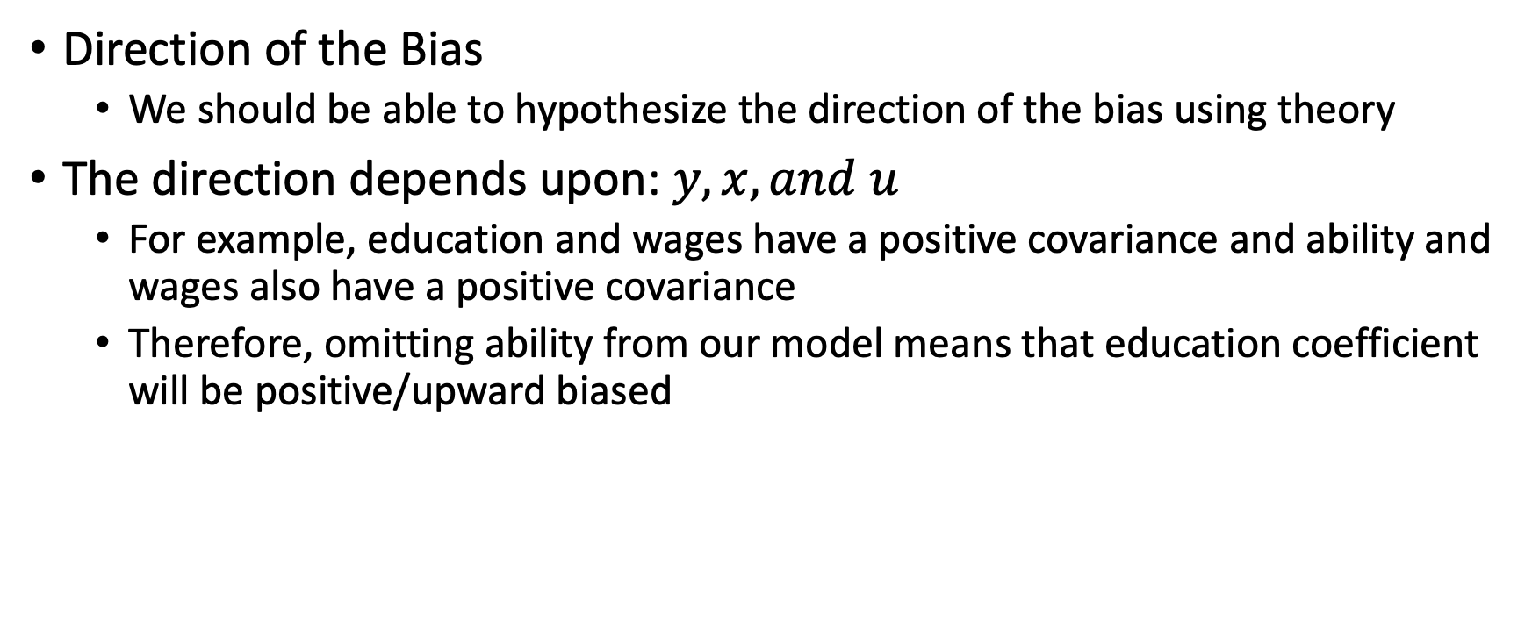
Omitted Variable Bias
Direction of the Bias
We should be able to hypothesize the direction of the bias using theory
The direction depends upon: $y,x, and u$
For example, education and wages have a positive covariance and ability and wages also have a positive covariance
Therefore, omitting ability from our model means that education coefficient will be positive/upward biased
Direction of Bias | $$Cov\left(x,u\right)>0$$ | $$Cov\left(x,u\right)<0$$
$$Cov\left(y,u\right)>0$$ | Positive Bias | Negative Bias
$$Cov\left(y,u\right)<0$$ | Negative Bias | Positive Bias

Slide 23
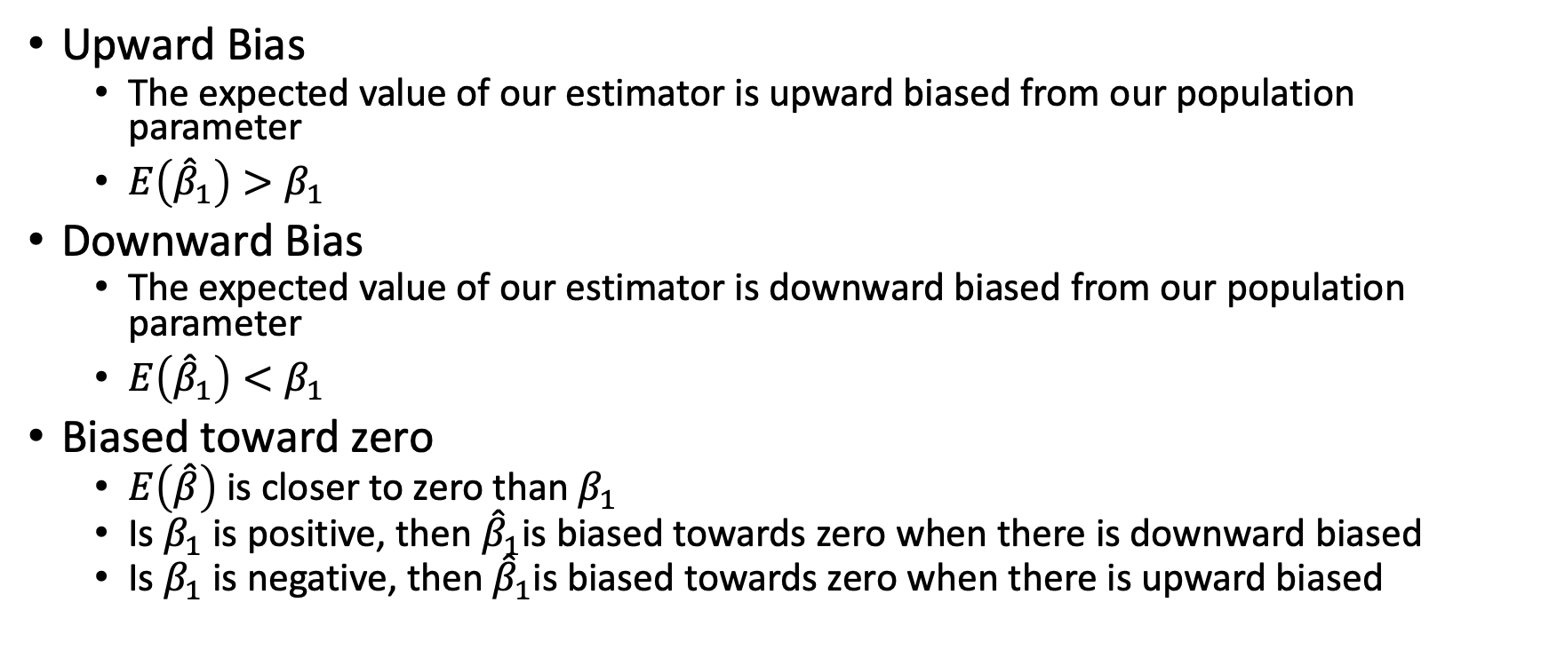
Omitted Variable Bias
Upward Bias
The expected value of our estimator is upward biased from our population parameter
$E\left({\hat{β}}_{1}\right)>β_{1}$
Downward Bias
The expected value of our estimator is downward biased from our population parameter
$E\left({\hat{β}}_{1}\right)<β_{1}$
Biased toward zero
$E\left(\hat{β}\right)$ is closer to zero than $β_{1}$
Is $β_{1}$ is positive, then ${\hat{β}}_{1}$is biased towards zero when there is downward biased
Is $β_{1}$ is negative, then ${\hat{β}}_{1}$is biased towards zero when there is upward biased

Slide 24
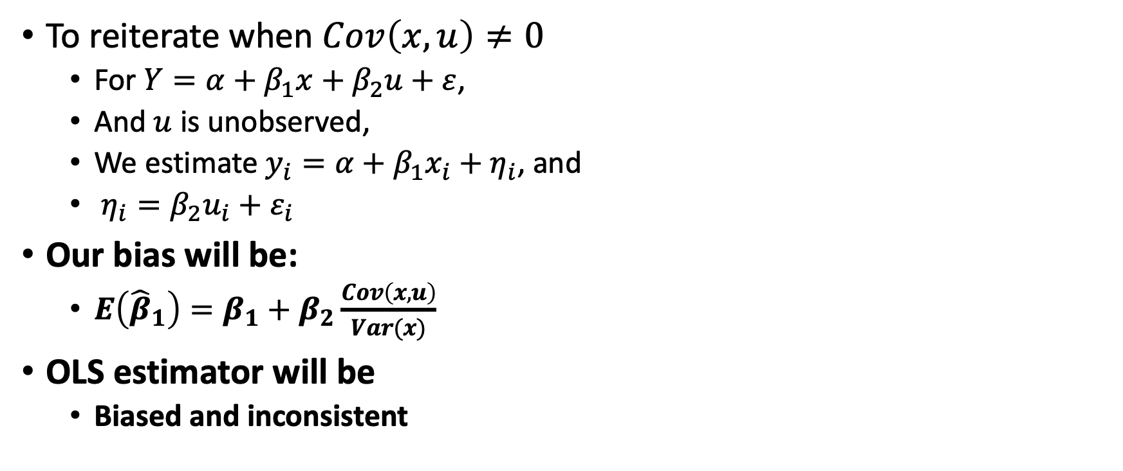
Omitted Variable Bias
To reiterate when $Cov\left(x,u\right)≠0$
For $Y=α+β_{1}x+β_{2}u+ε$,
And $u$ is unobserved,
We estimate $y_{i}=α+β_{1}x_{i}+η_{i}$, and
$η_{i}=β_{2}u_{i}+ε_{i}$
Our bias will be:
$E\left({\hat{β}}_{1}\right)=β_{1}+β_{2}\frac{Cov\left(x,u\right)}{Var(x)}$
OLS estimator will be
Biased and inconsistent

Slide 25
Omitted Variable Bias
What to do?
Go the economic theory
What should be included?
Go to the literature
What have others done?
Test for misspecification – RESET test, F-Test
Next Section
Get a better research design
Panel data, instrumental variables (covered in Econ 645 and in-depth in ECON 672)
Difference-in-difference, two-way fixed effects, regression discontinuity, matching (covered in Econ 672)

Slide 26
Endogeneity: Misspecification

Slide 27
Misspecification
What happens when the functional form is misspecified?
At best, we can have biased standard errors
(E.g.: missing data in the dependent variable)
At worst, we can have biased coefficients of the OLS estimator
(E.g.: omitted variables, etc.)
Functional Form Misspecification
A model suffers from function form misspecification when it does not properly address the relationship between the dependent and independent variables
This is a special case of omitted variable bias
This is when the omitted the proper functional form of an explanatory variable
What this means is that we have the correct variable but not the proper functional form of the variable

Slide 28
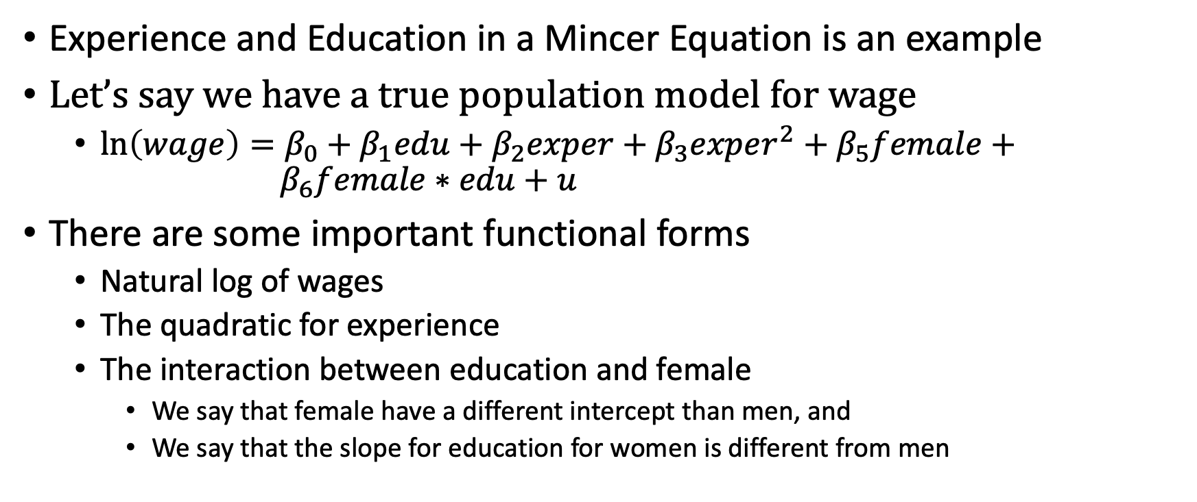
Misspecification
Experience and Education in a Mincer Equation is an example
Let’s say we have a true population model for wage
$\ln\left(wage\right)=β_{0}+β_{1}edu+β_{2}exper+β_{3}exper^{2}+β_{5}female+{ β}_{6}female∗edu+u$
There are some important functional forms
Natural log of wages
The quadratic for experience
The interaction between education and female
We say that female have a different intercept than men, and
We say that the slope for education for women is different from men

Slide 29
Misspecification
Topics for misspecification
F-Tests for joint exclusion restriction
RESET Test
Data transformations
Non-nested tests
Look for outliers
How to Test for misspecification
We can detect if we have functional form problems
F-Test for joint exclusion restriction
Regression Specification Error Test (RESET)

Slide 30
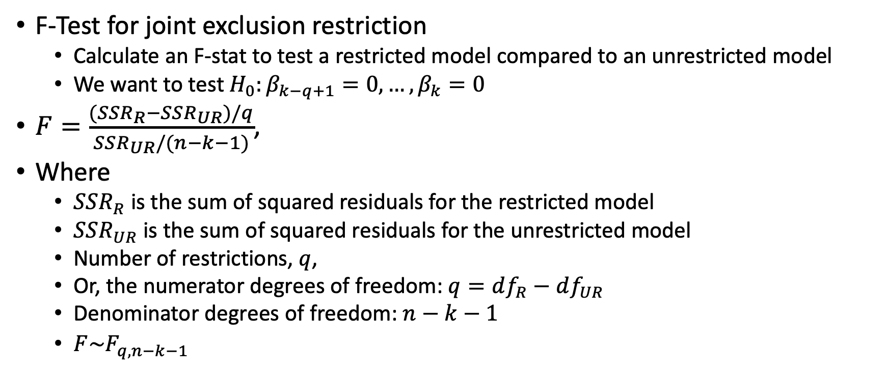
Misspecification
F-Test for joint exclusion restriction
Calculate an F-stat to test a restricted model compared to an unrestricted model
We want to test $H_{0}:β_{k−q+1}=0,…,β_{k}=0$
$F=\frac{(SSR_{R}−SSR_{UR})/q}{SSR_{UR}/(n−k−1)}$,
Where
$SSR_{R}$ is the sum of squared residuals for the restricted model
$SSR_{UR}$ is the sum of squared residuals for the unrestricted model
Number of restrictions, $q$,
Or, the numerator degrees of freedom: $q=df_{R}−df_{UR}$
Denominator degrees of freedom: $n−k−1$
$F\sim F_{q,n−k−1}$

Slide 31
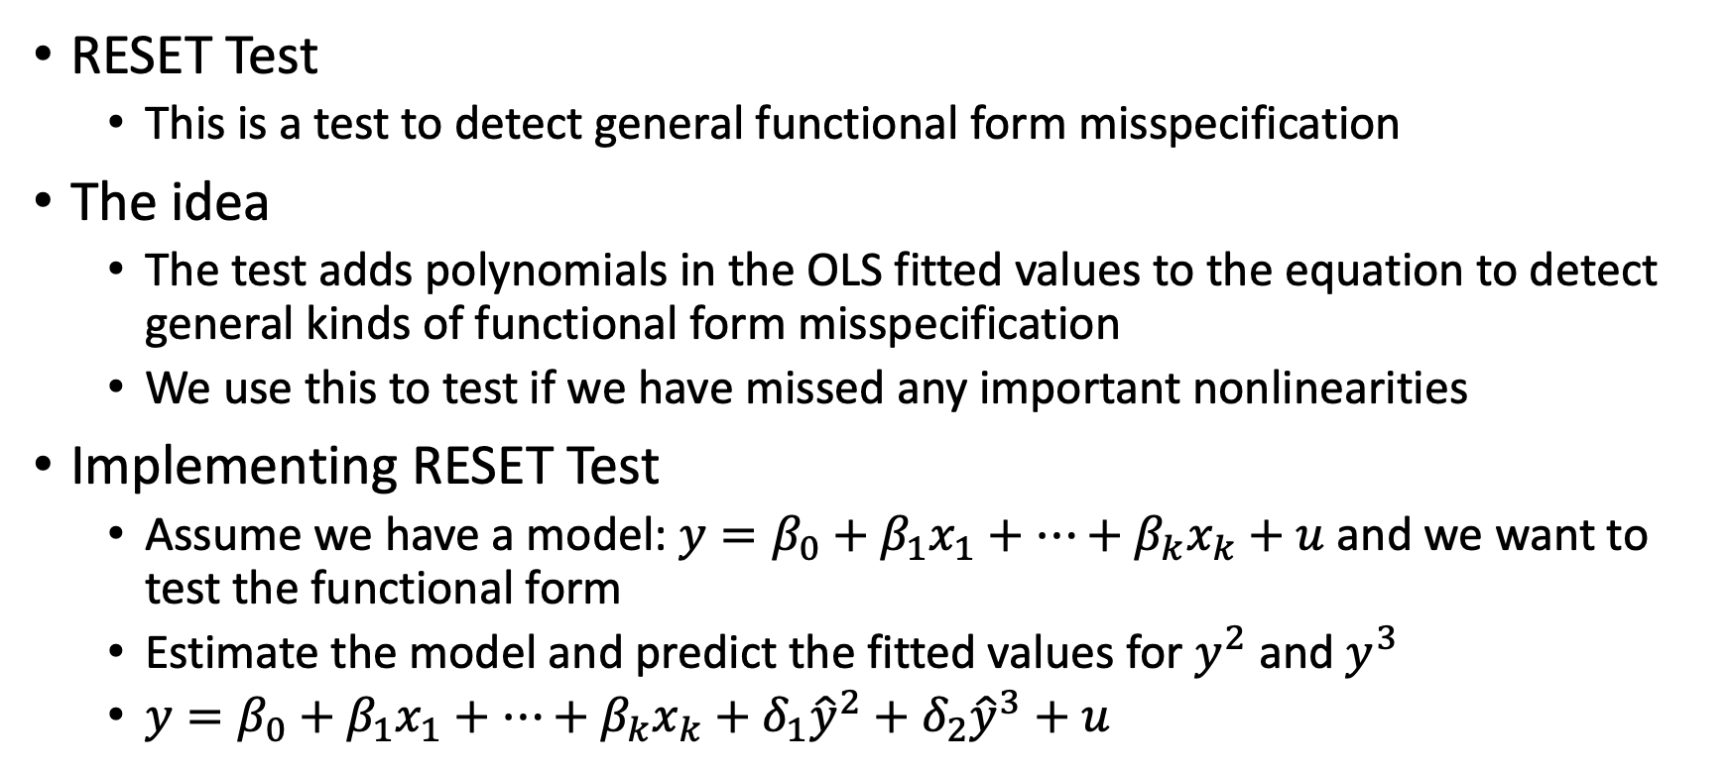
Misspecification
RESET Test
This is a test to detect general functional form misspecification
The idea
The test adds polynomials in the OLS fitted values to the equation to detect general kinds of functional form misspecification
We use this to test if we have missed any important nonlinearities
Implementing RESET Test
Assume we have a model: $y=β_{0}+β_{1}x_{1}+…+β_{k}x_{k}+u$ and we want to test the functional form
Estimate the model and predict the fitted values for $y^{2}$ and $y^{3}$
$y=β_{0}+β_{1}x_{1}+…+β_{k}x_{k}+δ_{1}{\hat{y}}^{2}+δ_{2}{\hat{y}}^{3}+u$

Slide 32
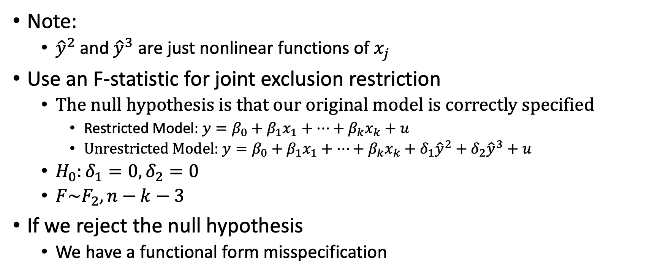
Misspecification
Note:
${\hat{y}}^{2}$ and ${\hat{y}}^{3}$ are just nonlinear functions of $x_{j}$
Use an F-statistic for joint exclusion restriction
The null hypothesis is that our original model is correctly specified
Restricted Model: $y=β_{0}+β_{1}x_{1}+…+β_{k}x_{k}+u$
Unrestricted Model: $y=β_{0}+β_{1}x_{1}+…+β_{k}x_{k}+δ_{1}{\hat{y}}^{2}+δ_{2}{\hat{y}}^{3}+u$
$H_{0}:δ_{1}=0, δ_{2}=0$
$F\sim F_{2},n−k−3$
If we reject the null hypothesis
We have a functional form misspecification

Slide 33
Misspecification
What it doesn’t do
It cannot tell us the correct functional form only that the current functional form is misspecified
It does not provide guidance on what is misspecified
Note
It does not pick up omitted variable when the omitted variables are linear
It does not pick up on any heteroskedasticity
We need to go to economic theory and literature

Slide 34
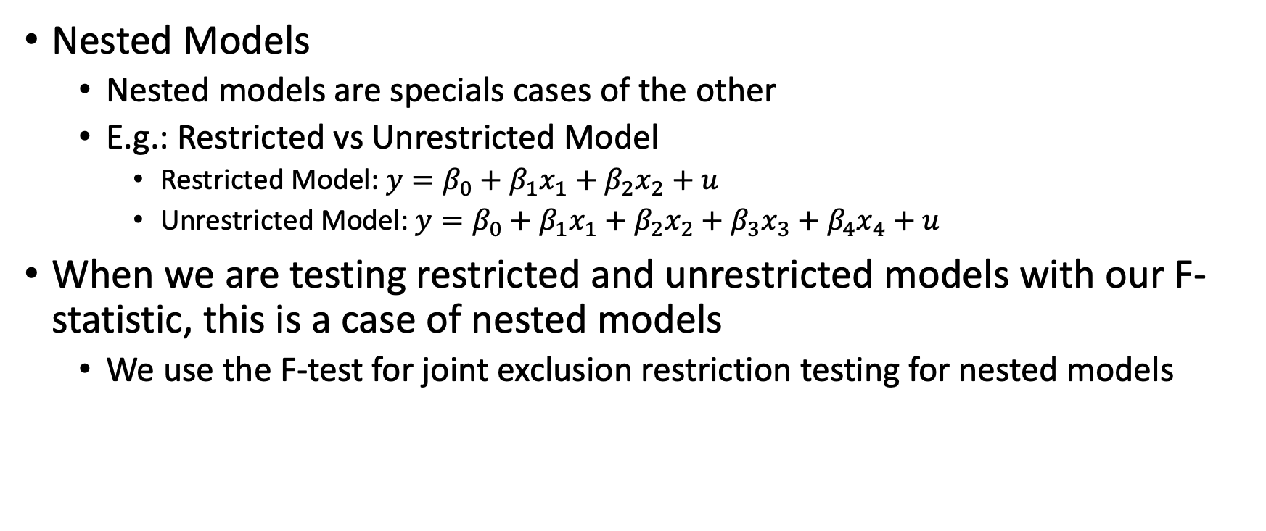
Misspecification
Nested Models
Nested models are specials cases of the other
E.g.: Restricted vs Unrestricted Model
Restricted Model: $y=β_{0}+β_{1}x_{1}+β_{2}x_{2}+u$
Unrestricted Model: $y=β_{0}+β_{1}x_{1}+β_{2}x_{2}+β_{3}x_{3}+β_{4}x_{4}+u$
When we are testing restricted and unrestricted models with our F-statistic, this is a case of nested models
We use the F-test for joint exclusion restriction testing for nested models

Slide 35
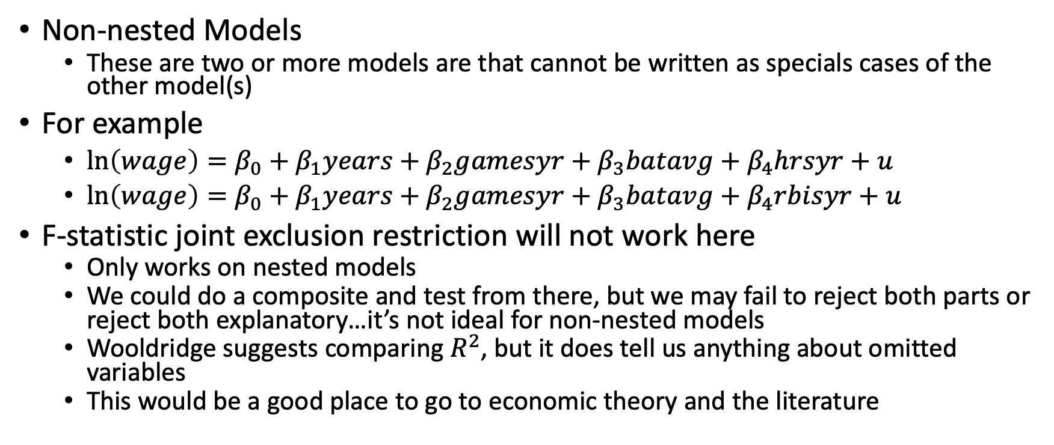
Misspecification
Non-nested Models
These are two or more models are that cannot be written as specials cases of the other model(s)
For example
$\ln\left(wage\right)=β_{0}+β_{1}years+β_{2}gamesyr+β_{3}batavg+β_{4}hrsyr+u$
$\ln\left(wage\right)=β_{0}+β_{1}years+β_{2}gamesyr+β_{3}batavg+β_{4}rbisyr+u$
F-statistic joint exclusion restriction will not work here
Only works on nested models
We could do a composite and test from there, but we may fail to reject both parts or reject both explanatory…it’s not ideal for non-nested models
Wooldridge suggests comparing $R^{2}$, but it does tell us anything about omitted variables
This would be a good place to go to economic theory and the literature

Slide 36
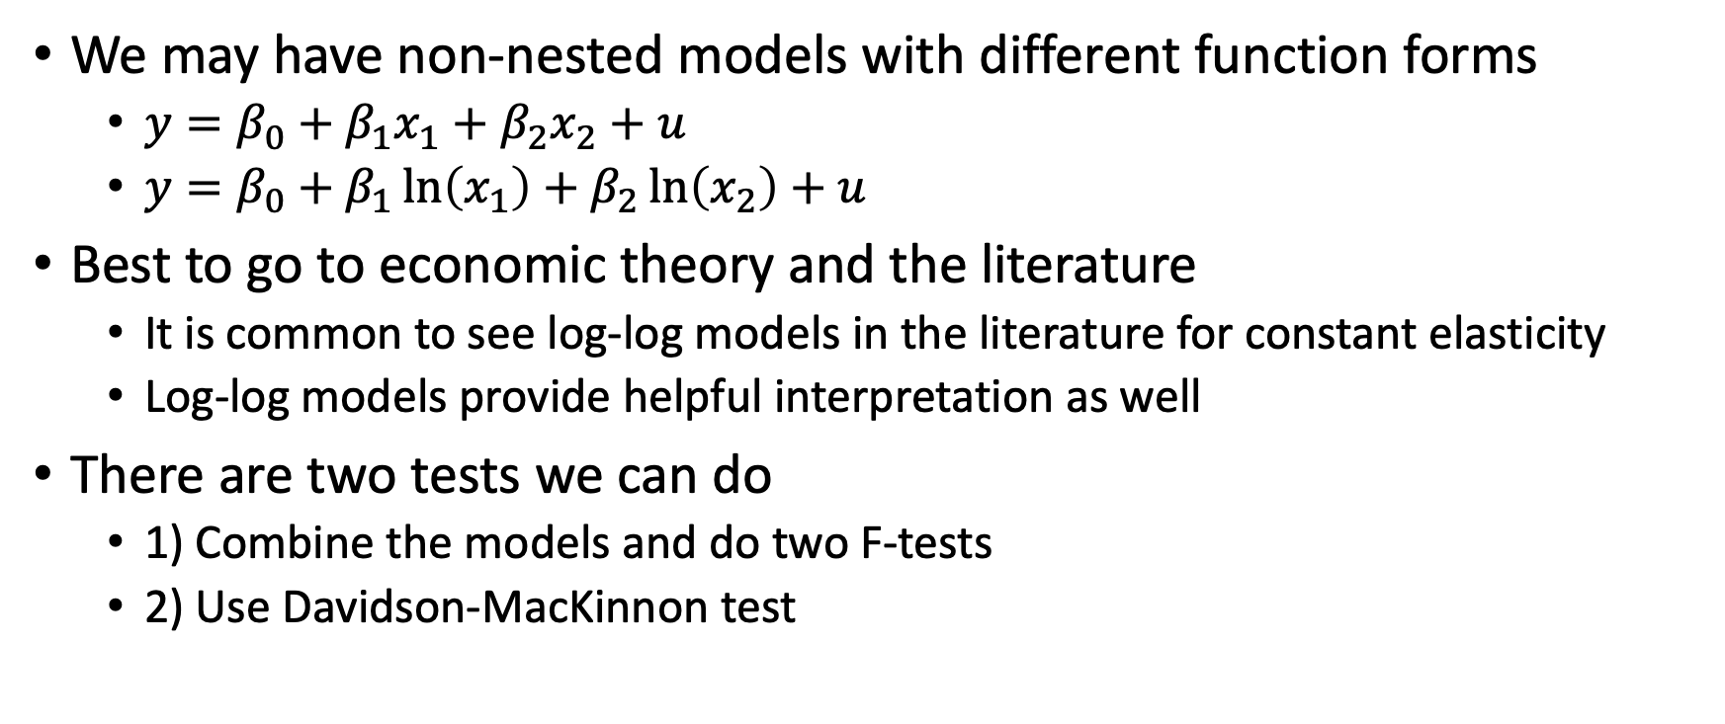
Misspecification
We may have non-nested models with different function forms
$y=β_{0}+β_{1}x_{1}+β_{2}x_{2}+u$
$y=β_{0}+β_{1}\ln\left(x_{1}\right)+β_{2}\ln\left(x_{2}\right)+u$
Best to go to economic theory and the literature
It is common to see log-log models in the literature for constant elasticity
Log-log models provide helpful interpretation as well
There are two tests we can do
1) Combine the models and do two F-tests
2) Use Davidson-MacKinnon test

Slide 37
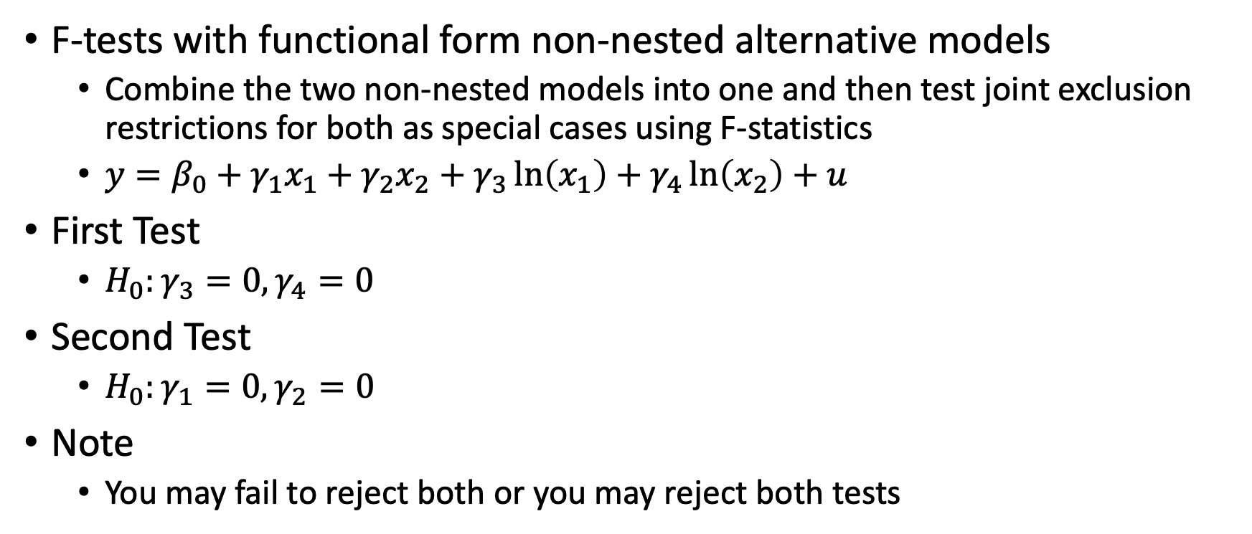
Misspecification
F-tests with functional form non-nested alternative models
Combine the two non-nested models into one and then test joint exclusion restrictions for both as special cases using F-statistics
$y=β_{0}+γ_{1}x_{1}+γ_{2}x_{2}+γ_{3}\ln\left(x_{1}\right)+γ_{4}\ln\left(x_{2}\right)+u$
First Test
$H_{0}:γ_{3}=0, γ_{4}=0$
Second Test
$H_{0}:γ_{1}=0, γ_{2}=0$
Note
You may fail to reject both or you may reject both tests

Slide 38
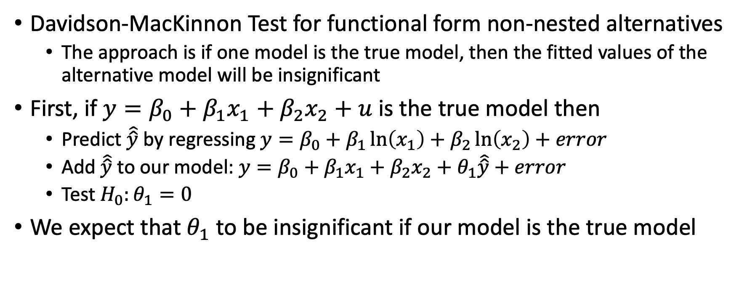
Misspecification
Davidson-MacKinnon Test for functional form non-nested alternatives
The approach is if one model is the true model, then the fitted values of the alternative model will be insignificant
First, if $y=β_{0}+β_{1}x_{1}+β_{2}x_{2}+u$is the true model then
Predict $\hat{\hat{y}}$ by regressing $y=β_{0}+β_{1}\ln\left(x_{1}\right)+β_{2}\ln\left(x_{2}\right)+error$
Add $\hat{\hat{y}}$ to our model: $y=β_{0}+β_{1}x_{1}+β_{2}x_{2}+θ_{1}\hat{\hat{y}}+error$
Test $H_{0}:θ_{1}=0$
We expect that $θ_{1}$ to be insignificant if our model is the true model

Slide 39
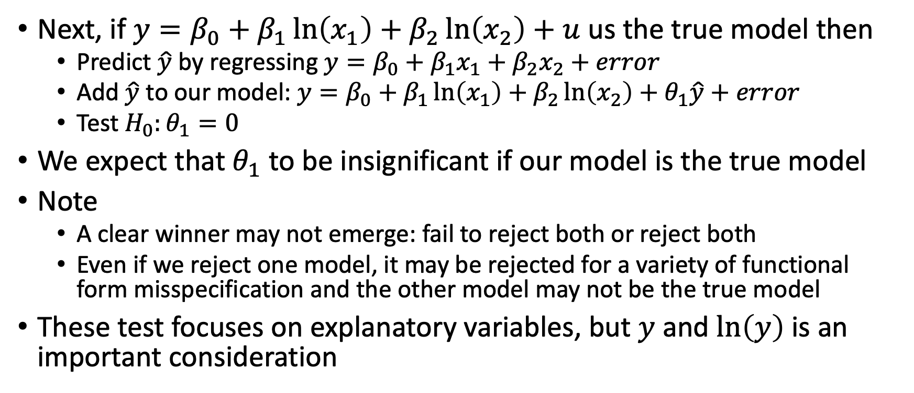
Misspecification
Next, if $y=β_{0}+β_{1}\ln\left(x_{1}\right)+β_{2}\ln\left(x_{2}\right)+u$ us the true model then
Predict $\hat{y}$ by regressing $y=β_{0}+β_{1}x_{1}+β_{2}x_{2}+error$
Add $\hat{y}$ to our model: $y=β_{0}+β_{1}\ln\left(x_{1}\right)+β_{2}\ln\left(x_{2}\right)+θ_{1}\hat{y}+error$
Test $H_{0}:θ_{1}=0$
We expect that $θ_{1}$ to be insignificant if our model is the true model
Note
A clear winner may not emerge: fail to reject both or reject both
Even if we reject one model, it may be rejected for a variety of functional form misspecification and the other model may not be the true model
These test focuses on explanatory variables, but $y$ and $\ln\left(y\right)$ is an important consideration

Slide 40
Misspecification
What to Do?
Go the economic theory
What should be included?
Go to the literature
What have others done?
Test, Test, Test

Slide 41
Endogeneity: Measurement Error

Slide 42
Measurement Error
Measurement Error
Sometimes we cannot collect or imperfect collect data on the variable of interest that affects economic behavior
The variable that we do not observe has a well-defined, quantitative meaning, such as marginal tax rate, wages, wealth, etc.,
However, our recorded measures of the variable may contain errors
Example
Reported income vs actual income (CPS vs IRS admin data)
Proxy variable vs measurement error
A proxy variable is a variable that we us to control for an unobserved confounder
Measurement error are errors within a well-defined quantitative variable
Note: both have similar consequences but are different concepts

Slide 43
Measurement Error
We’ll cover two types of measurement errors
Measurement Error in Dependent Variables
Measurement Error in Independent Variables
Both have consequences for our OLS estimator
At best, we’ll have larger standard errors of our OLS estimator
At worst, the OLS estimator will be biased and inconsistent

Slide 44
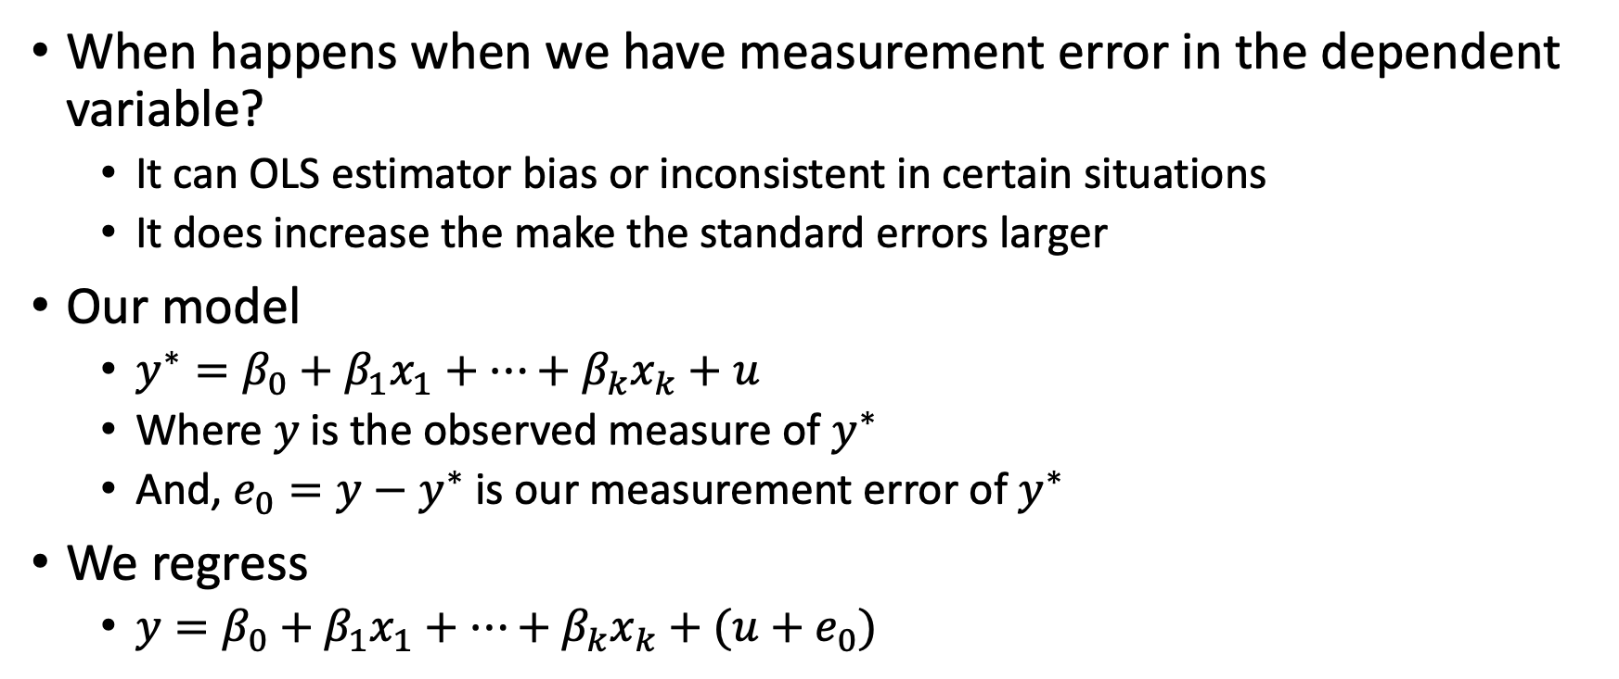
Measurement Error in Dependent Variable
When happens when we have measurement error in the dependent variable?
It can OLS estimator bias or inconsistent in certain situations
It does increase the make the standard errors larger
Our model
$y^{∗}=β_{0}+β_{1}x_{1}+…+β_{k}x_{k}+u$
Where $y$ is the observed measure of $y^{∗}$
And, $e_{0}=y−y^{∗}$ is our measurement error of $y^{∗}$
We regress
$y=β_{0}+β_{1}x_{1}+…+β_{k}x_{k}+(u+e_{0})$

Slide 45
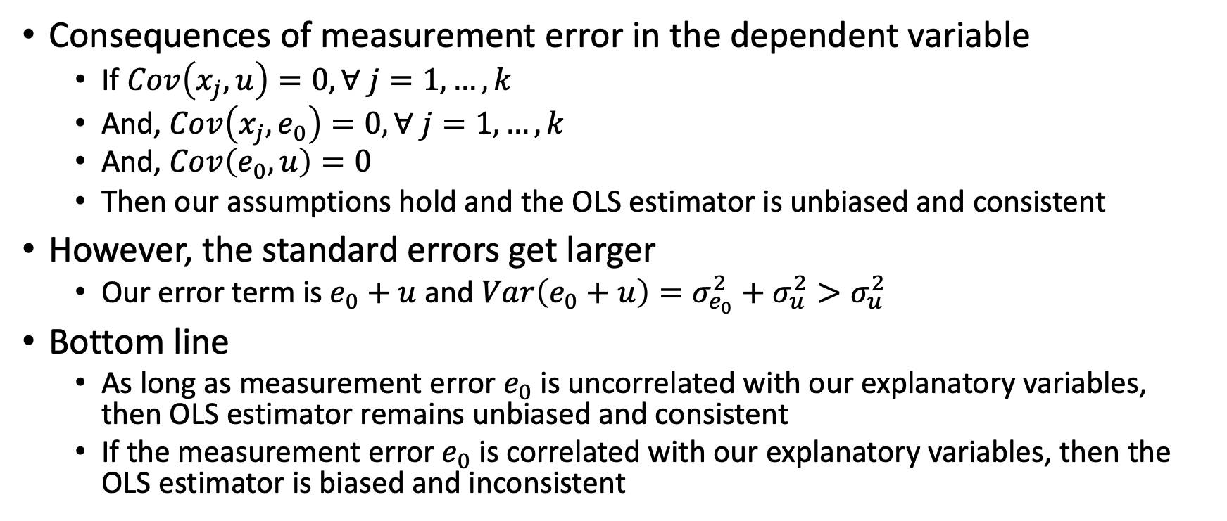
Measurement Error in Dependent Variable
Consequences of measurement error in the dependent variable
If $Cov\left(x_{j},u\right)=0, ∀ j=1,…,k$
And, $Cov\left(x_{j}, e_{0}\right)=0, ∀ j=1,…,k$
And, $Cov\left(e_{0},u\right)=0$
Then our assumptions hold and the OLS estimator is unbiased and consistent
However, the standard errors get larger
Our error term is $e_{0}+u$ and $Var\left(e_{0}+u\right)=σ_{e_{0}}^{2}+σ_{u}^{2}>σ_{u}^{2}$
Bottom line
As long as measurement error $e_{0}$ is uncorrelated with our explanatory variables, then OLS estimator remains unbiased and consistent
If the measurement error $e_{0}$ is correlated with our explanatory variables, then the OLS estimator is biased and inconsistent

Slide 46
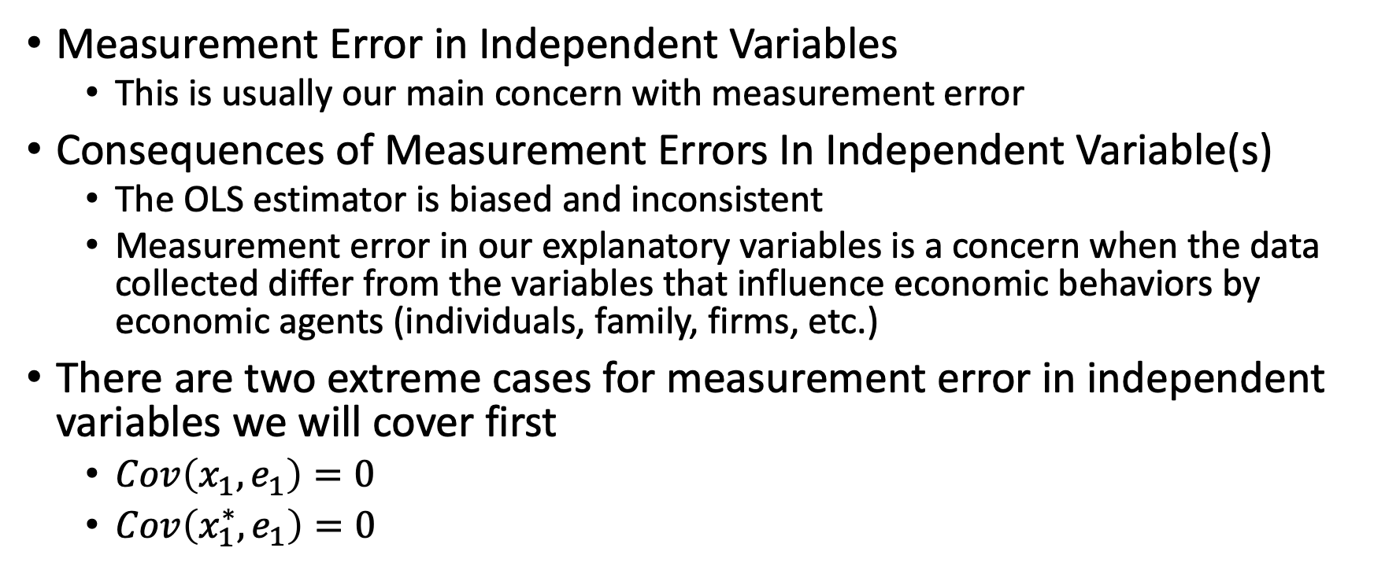
Measurement Error in Independent Variables
Measurement Error in Independent Variables
This is usually our main concern with measurement error
Consequences of Measurement Errors In Independent Variable(s)
The OLS estimator is biased and inconsistent
Measurement error in our explanatory variables is a concern when the data collected differ from the variables that influence economic behaviors by economic agents (individuals, family, firms, etc.)
There are two extreme cases for measurement error in independent variables we will cover first
$Cov\left(x_{1},e_{1}\right)=0$
$Cov\left(x_{1}^{∗},e_{1}\right)=0$

Slide 47
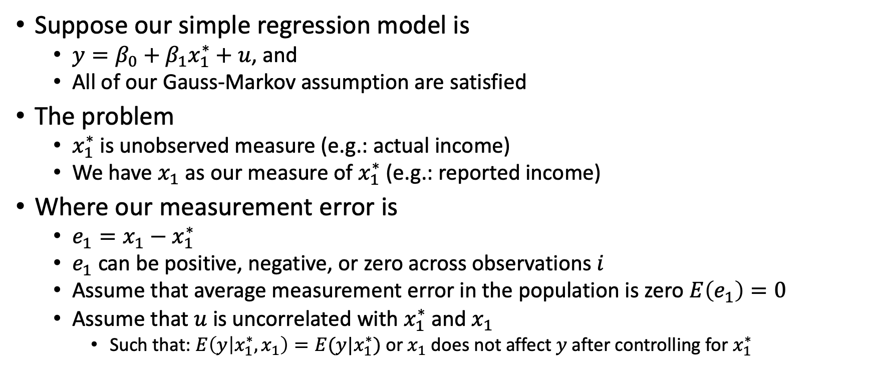
Measurement Error in Independent Variables
Suppose our simple regression model is
$y=β_{0}+β_{1}x_{1}^{∗}+u$, and
All of our Gauss-Markov assumption are satisfied
The problem
$x_{1}^{∗}$ is unobserved measure (e.g.: actual income)
We have $x_{1}$ as our measure of $x_{1}^{∗}$ (e.g.: reported income)
Where our measurement error is
$e_{1}=x_{1}−x_{1}^{∗}$
$e_{1}$ can be positive, negative, or zero across observations $i$
Assume that average measurement error in the population is zero $E\left(e_{1}\right)=0$
Assume that $u$ is uncorrelated with $x_{1}^{∗}$ and $x_{1}$
Such that: $E\left(y | x_{1}^{∗}, x_{1}\right)=E(y|x_{1}^{∗})$ or $x_{1}$ does not affect $y$ after controlling for $x_{1}^{∗}$

Slide 48
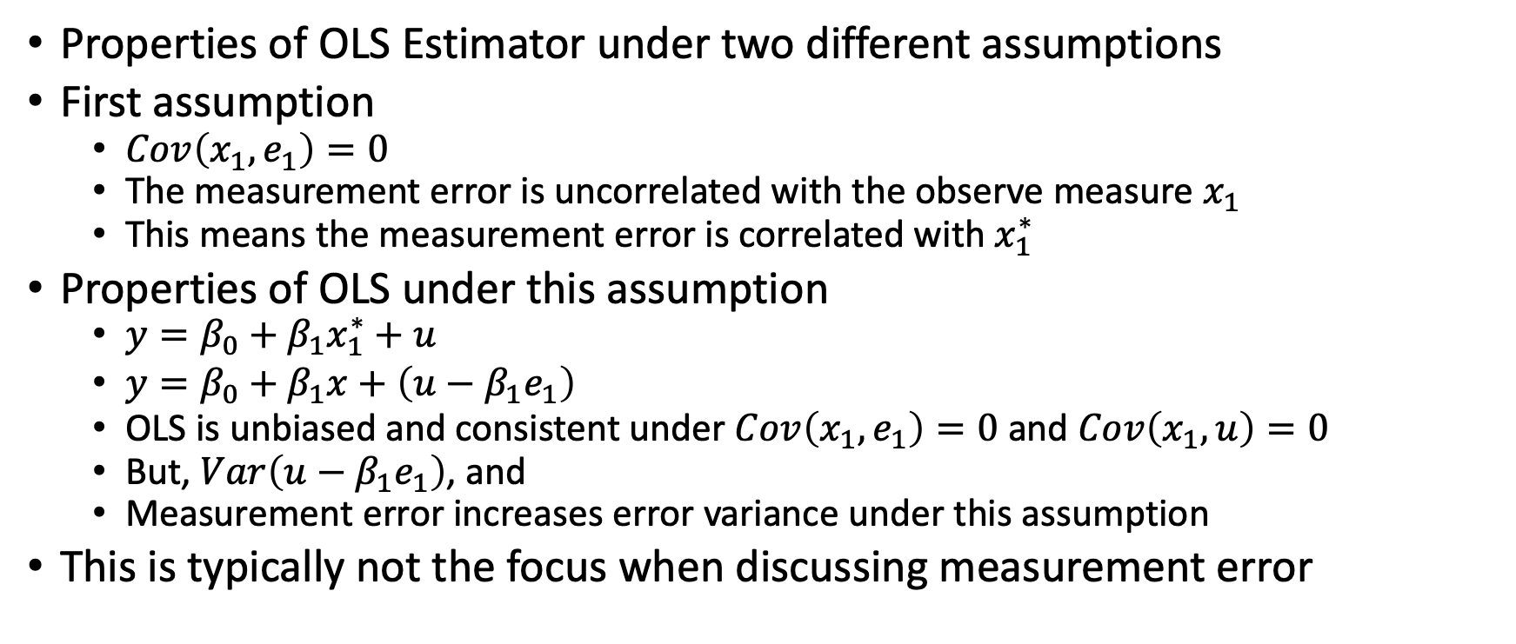
Measurement Error in Independent Variables
Properties of OLS Estimator under two different assumptions
First assumption
$Cov\left(x_{1},e_{1}\right)=0$
The measurement error is uncorrelated with the observe measure $x_{1}$
This means the measurement error is correlated with $x_{1}^{∗}$
Properties of OLS under this assumption
$y=β_{0}+β_{1}x_{1}^{∗}+u$
$y=β_{0}+β_{1}x+\left(u−β_{1}e_{1}\right)$
OLS is unbiased and consistent under $Cov\left(x_{1},e_{1}\right)=0$ and $Cov\left(x_{1},u\right)=0$
But, $Var\left(u−β_{1}e_{1}\right)$, and
Measurement error increases error variance under this assumption
This is typically not the focus when discussing measurement error

Slide 49
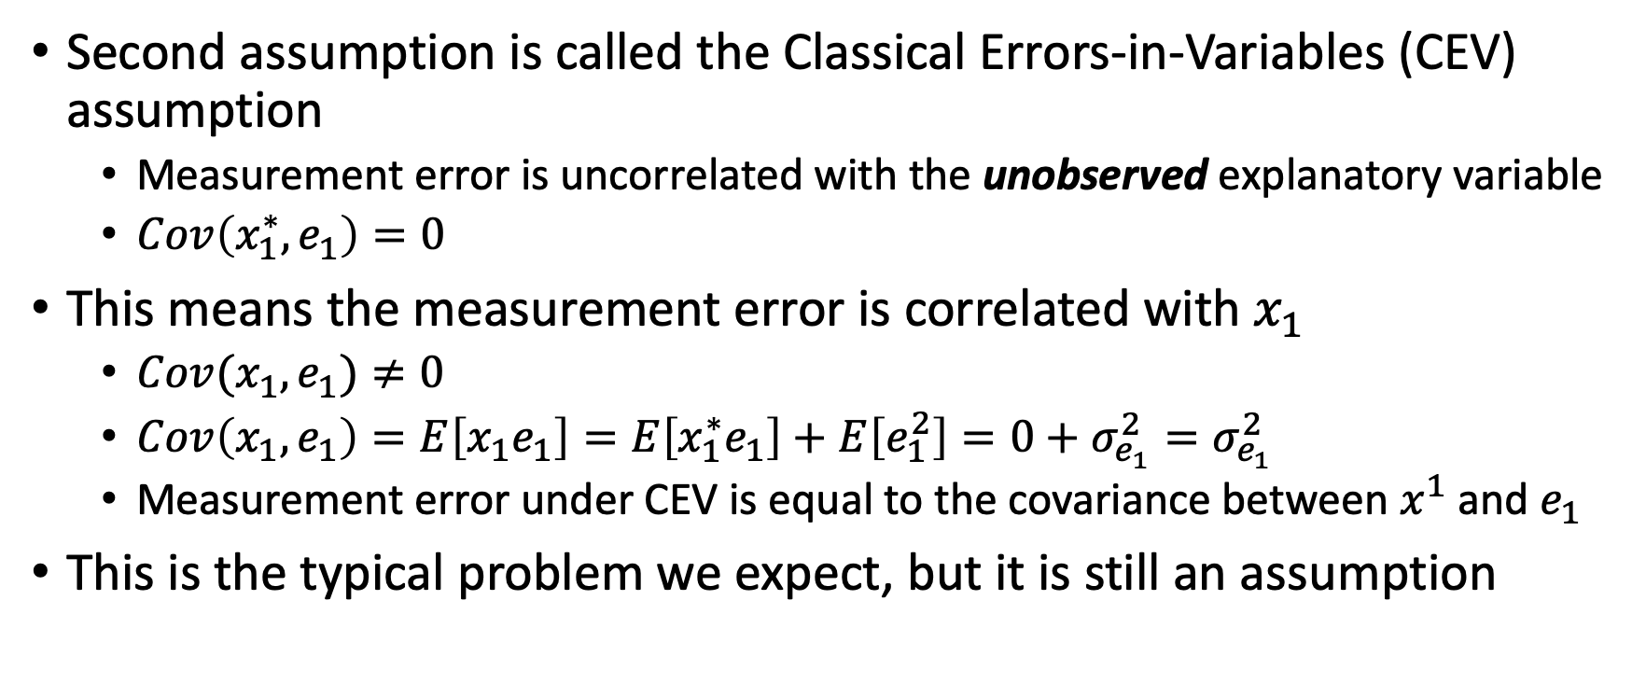
Measurement Error under CEV
Second assumption is called the Classical Errors-in-Variables (CEV) assumption
Measurement error is uncorrelated with the unobserved explanatory variable
$Cov\left(x_{1}^{∗},e_{1}\right)=0$
This means the measurement error is correlated with $x_{1}$
$Cov(x_{1},e_{1})≠0$
$Cov\left(x_{1},e_{1}\right)=E\left[x_{1}e_{1}\right]=E\left[x_{1}^{∗}e_{1}\right]+E\left[e_{1}^{2}\right]=0+σ_{e_{1}}^{2}=σ_{e_{1}}^{2}$
Measurement error under CEV is equal to the covariance between $x^{1}$ and $e_{1}$
This is the typical problem we expect, but it is still an assumption

Slide 50
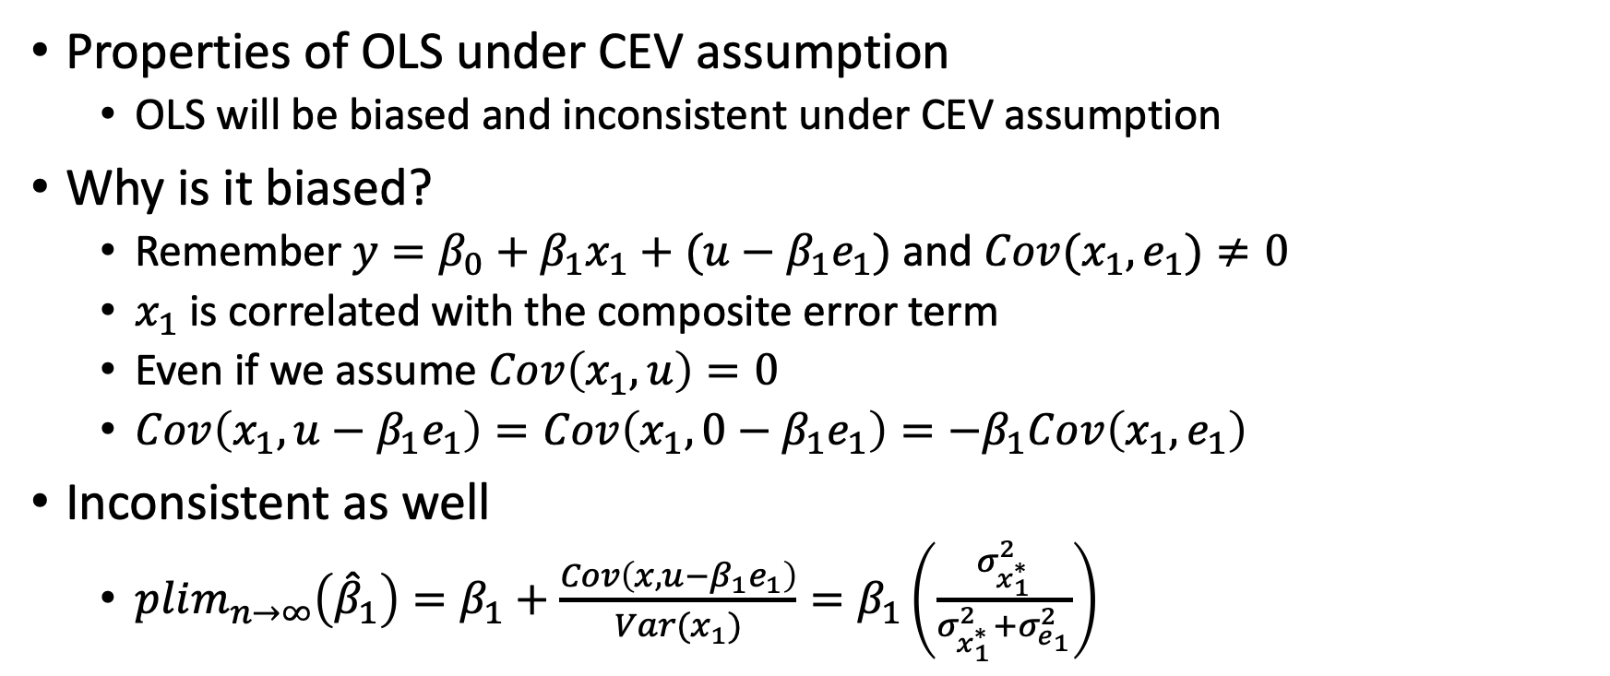
Measurement Error under CEV
Properties of OLS under CEV assumption
OLS will be biased and inconsistent under CEV assumption
Why is it biased?
Remember $y=β_{0}+β_{1}x_{1}+(u−β_{1}e_{1})$ and $Cov(x_{1},e_{1})≠0$
$x_{1}$ is correlated with the composite error term
Even if we assume $Cov\left(x_{1},u\right)=0$
$Cov\left(x_{1},u−β_{1}e_{1}\right)=Cov\left(x_{1},0−β_{1}e_{1}\right)=−β_{1}Cov\left(x_{1},e_{1}\right)$
Inconsistent as well
$plim_{n→∞}\left({\hat{β}}_{1}\right)=β_{1}+\frac{Cov\left(x,u−β_{1}e_{1}\right)}{Var(x_{1})}=β_{1}\left(\frac{σ_{x_{1}^{∗}}^{2}}{σ_{x_{1}^{∗}}^{2}+σ_{e_{1}}^{2}}\right)$

Slide 51
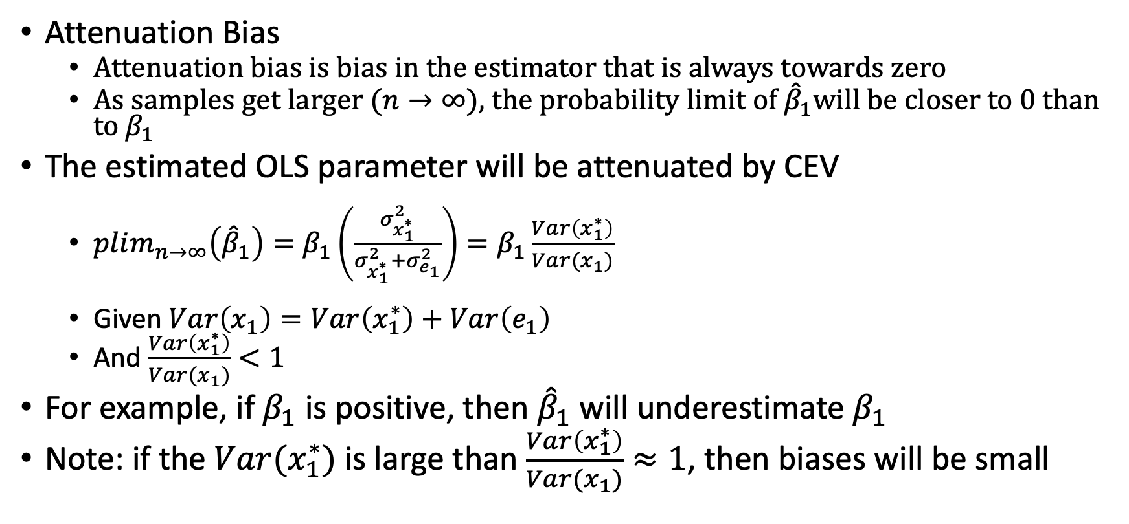
Measurement Error under CEV
Attenuation Bias
Attenuation bias is bias in the estimator that is always towards zero
As samples get larger ($n→∞)$, the probability limit of ${\hat{β}}_{1}$will be closer to 0 than to $β_{1}$
The estimated OLS parameter will be attenuated by CEV
$plim_{n→∞}\left({\hat{β}}_{1}\right)=β_{1}\left(\frac{σ_{x_{1}^{∗}}^{2}}{σ_{x_{1}^{∗}}^{2}+σ_{e_{1}}^{2}}\right)=β_{1}\frac{Var\left(x_{1}^{∗}\right)}{Var(x_{1})}$
Given $Var\left(x_{1}\right)=Var\left(x_{1}^{∗}\right)+Var\left(e_{1}\right)$
And $\frac{Var\left(x_{1}^{∗}\right)}{Var(x_{1})}<1$
For example, if $β_{1}$ is positive, then ${\hat{β}}_{1}$ will underestimate $β_{1}$
Note: if the $Var(x_{1}^{∗})$ is large than $\frac{Var\left(x_{1}^{∗}\right)}{Var(x_{1})}≈1$, then biases will be small

Slide 52
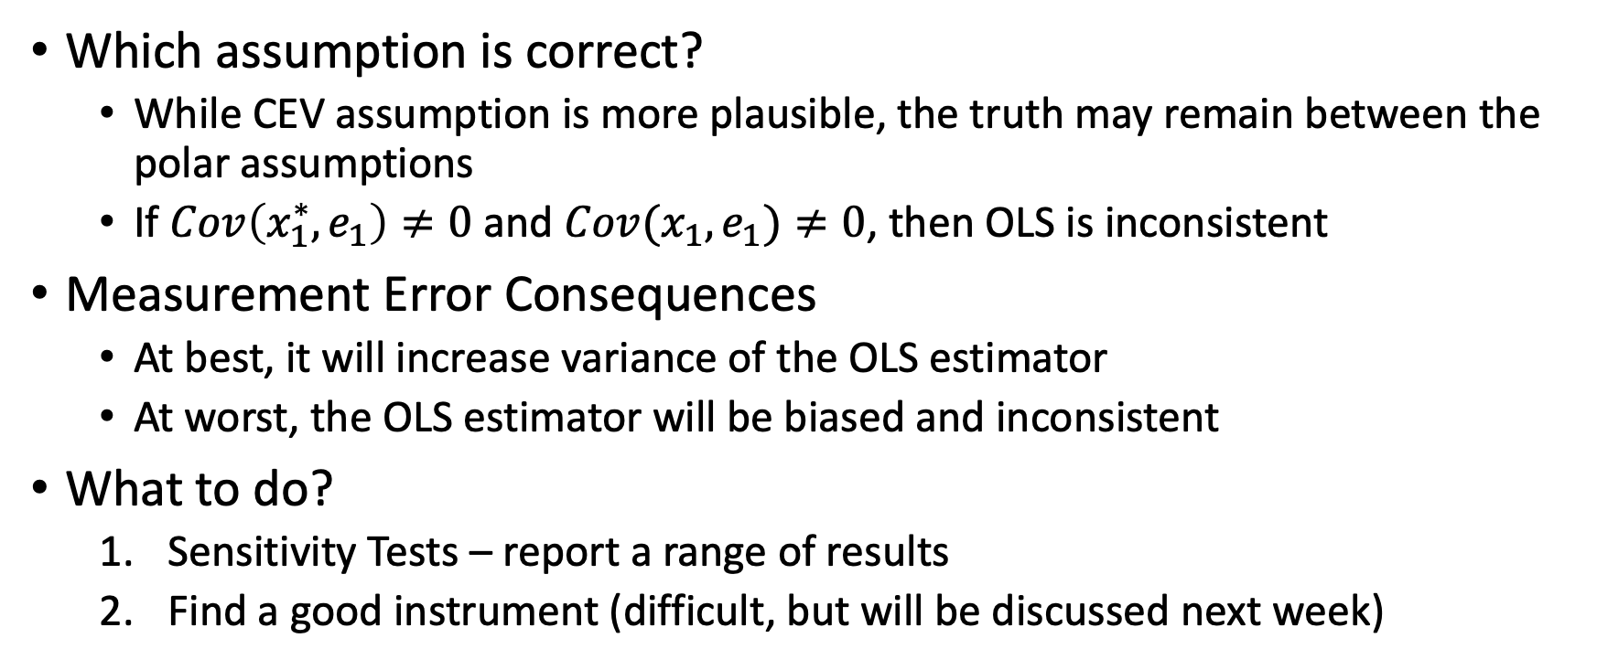
Measurement Error in Independent Variables
Which assumption is correct?
While CEV assumption is more plausible, the truth may remain between the polar assumptions
If $Cov\left(x_{1}^{∗},e_{1}\right)≠0$ and $Cov(x_{1},e_{1})≠0$, then OLS is inconsistent
Measurement Error Consequences
At best, it will increase variance of the OLS estimator
At worst, the OLS estimator will be biased and inconsistent
What to do?
Sensitivity Tests – report a range of results
Find a good instrument (difficult, but will be discussed next week)

Slide 53
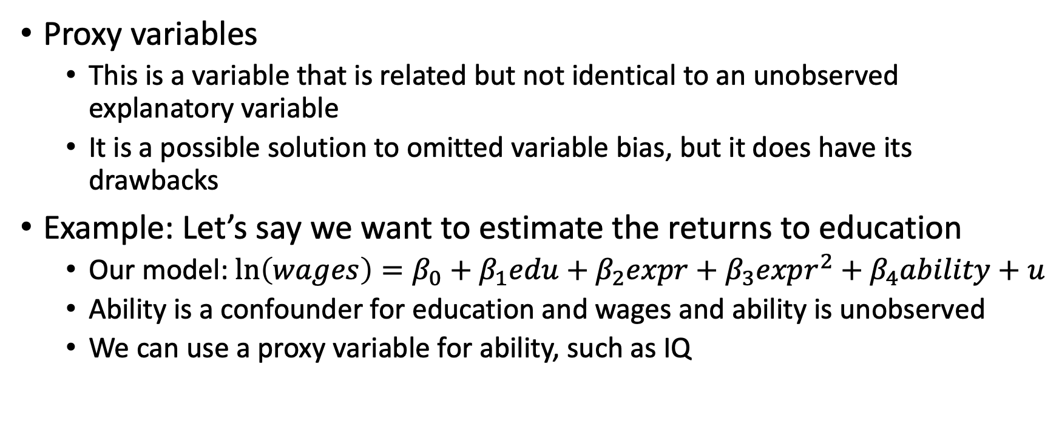
Proxy Variables
Proxy variables
This is a variable that is related but not identical to an unobserved explanatory variable
It is a possible solution to omitted variable bias, but it does have its drawbacks
Example: Let’s say we want to estimate the returns to education
Our model: $\ln\left(wages\right)=β_{0}+β_{1}edu+β_{2}expr+β_{3}expr^{2}+β_{4}ability+u$
Ability is a confounder for education and wages and ability is unobserved
We can use a proxy variable for ability, such as IQ

Slide 54
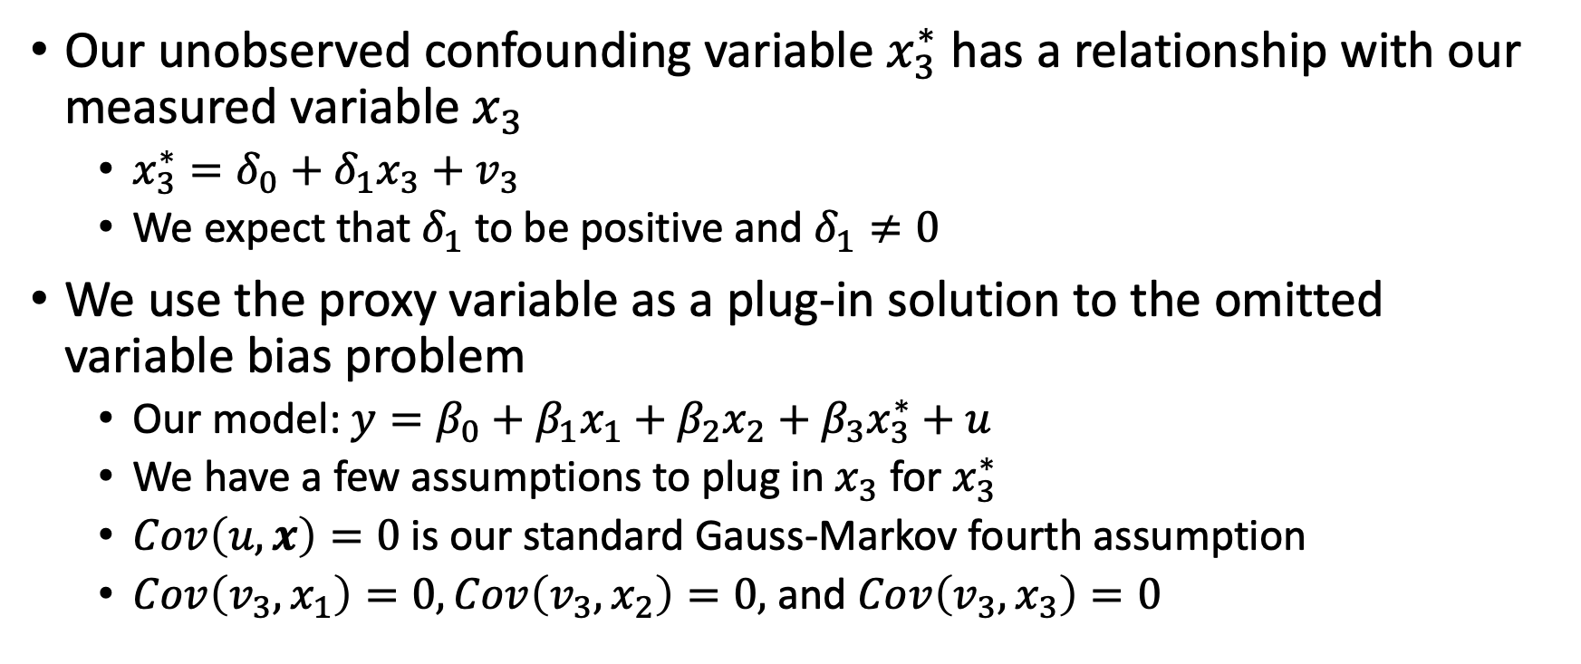
Proxy Variables
Our unobserved confounding variable $x_{3}^{∗}$ has a relationship with our measured variable $x_{3}$
$x_{3}^{∗}=δ_{0}+δ_{1}x_{3}+v_{3}$
We expect that $δ_{1}$ to be positive and $δ_{1}≠0$
We use the proxy variable as a plug-in solution to the omitted variable bias problem
Our model: $y=β_{0}+β_{1}x_{1}+β_{2}x_{2}+β_{3}x_{3}^{∗}+u$
We have a few assumptions to plug in $x_{3}$ for $x_{3}^{∗}$
$Cov\left(u,x\right)=0$ is our standard Gauss-Markov fourth assumption
$Cov\left(v_{3},x_{1}\right)=0, Cov\left(v_{3},x_{2}\right)=0,$ and $Cov\left(v_{3},x_{3}\right)=0$

Slide 55
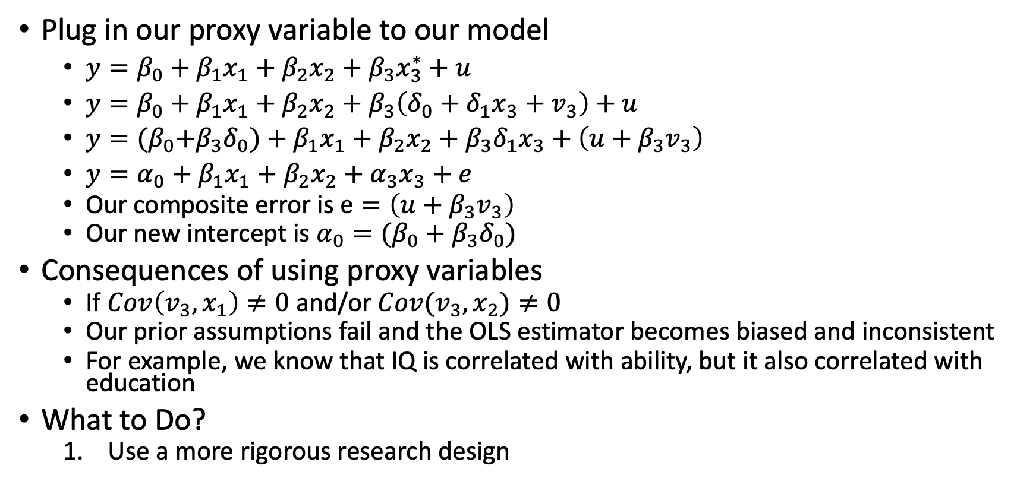
Proxy Variables
Plug in our proxy variable to our model
$y=β_{0}+β_{1}x_{1}+β_{2}x_{2}+β_{3}x_{3}^{∗}+u$
$y=β_{0}+β_{1}x_{1}+β_{2}x_{2}+β_{3}\left(δ_{0}+δ_{1}x_{3}+v_{3}\right)+u$
$y={(β}_{0}+β_{3}δ_{0})+β_{1}x_{1}+β_{2}x_{2}+β_{3}δ_{1}x_{3}+\left(u+β_{3}v_{3}\right)$
$y=α_{0}+β_{1}x_{1}+β_{2}x_{2}+α_{3}x_{3}+e$
Our composite error is $e=\left(u+β_{3}v_{3}\right)$
Our new intercept is $α_{0}=(β_{0}+β_{3}δ_{0})$
Consequences of using proxy variables
If $Cov\left(v_{3},x_{1}\right)≠0$ and/or $Cov(v_{3},x_{2})≠0$
Our prior assumptions fail and the OLS estimator becomes biased and inconsistent
For example, we know that IQ is correlated with ability, but it also correlated with education
What to Do?
Use a more rigorous research design

Slide 56
Endogeneity: Missing Data and Outliers

Slide 57
Missing Data
The impact of missing data on the OLS estimator depends upon why the data are missing
There are two considerations with missing data
Random missing data
Nonrandom missing data
Note:
Any observation that is missing data in either the dependent or independent variables cannot be used in a multivariate regression,
The observation will be dropped

Slide 58
Missing Data
When data are missing at random
This does not violate the second Gauss-Markov assumption
2nd GMA is that we have a random sampling of observations
Consequences of data missing at random
OLS estimators remain unbiased and consistent
The precision of the OLS estimator is reduced due to lower sample size
This means the standard errors of the OLS estimator increase but are not biased
Note
This is not very common in practice

Slide 59
Missing Data
When data are not randomly missing (nonrandom sampling)
We need to worry about a violation of the 2nd Gauss-Markov assumption on our OLS estimator
Consequences depend upon the type of sample selection
Exogenous sample selection
Endogenous sample selection
Stratified survey

Slide 60
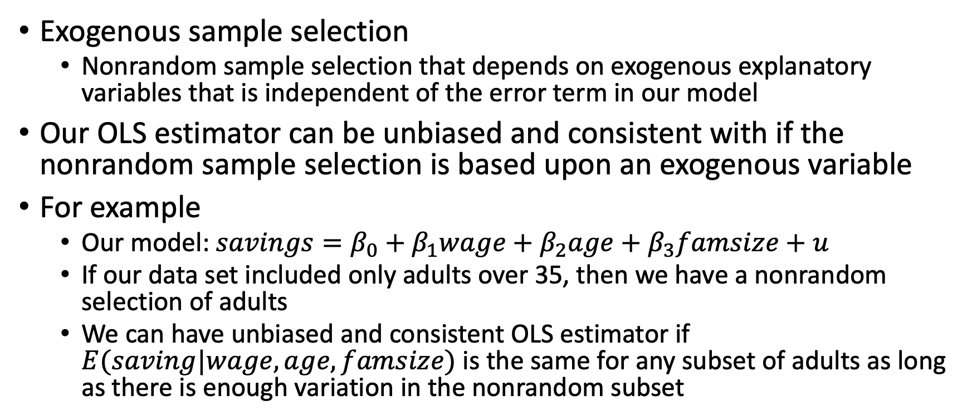
Missing Data
Exogenous sample selection
Nonrandom sample selection that depends on exogenous explanatory variables that is independent of the error term in our model
Our OLS estimator can be unbiased and consistent with if the nonrandom sample selection is based upon an exogenous variable
For example
Our model: $savings=β_{0}+β_{1}wage+β_{2}age+β_{3}famsize+u$
If our data set included only adults over 35, then we have a nonrandom selection of adults
We can have unbiased and consistent OLS estimator if $E(saving|wage,age,famsize)$ is the same for any subset of adults as long as there is enough variation in the nonrandom subset

Slide 61
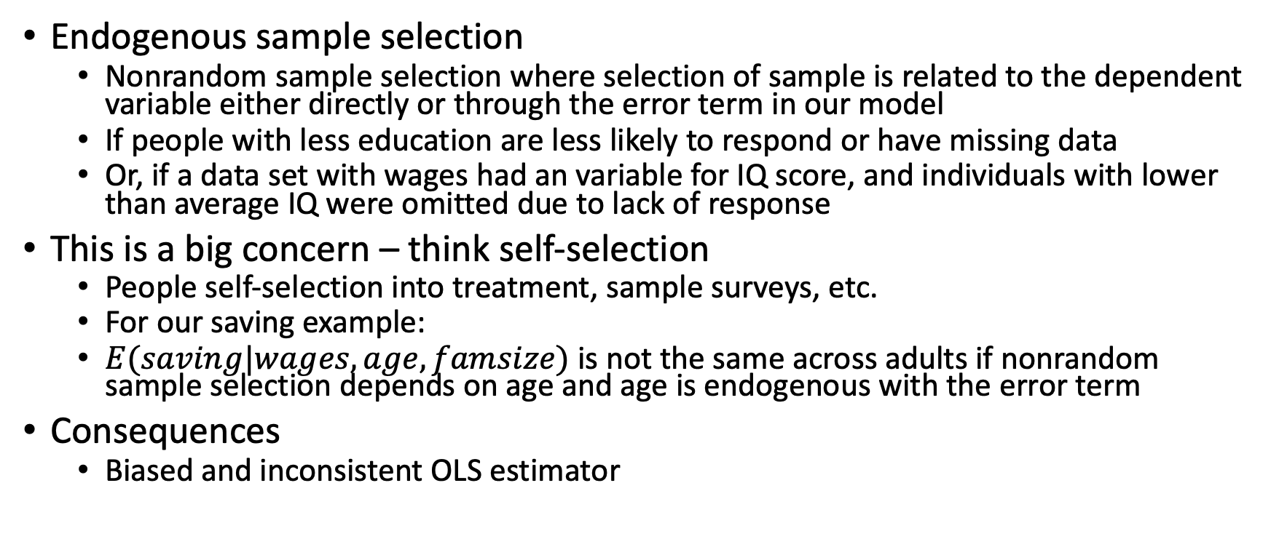
Missing Data
Endogenous sample selection
Nonrandom sample selection where selection of sample is related to the dependent variable either directly or through the error term in our model
If people with less education are less likely to respond or have missing data
Or, if a data set with wages had an variable for IQ score, and individuals with lower than average IQ were omitted due to lack of response
This is a big concern – think self-selection
People self-selection into treatment, sample surveys, etc.
For our saving example:
$E(saving|wages,age,famsize)$ is not the same across adults if nonrandom sample selection depends on age and age is endogenous with the error term
Consequences
Biased and inconsistent OLS estimator

Slide 62
Missing Data
Other types of endogenous nonrandom sample selection
The variable of interest may not be in the dataset
For example,
We are interested in wage offer
For people who work, wage offer is their wage
For people who do not work, they may have a wage offer but choose not to work and we do not observe their wage offer (think reservation wage in a labor supply model).
What to Do
We will cover sample selection correction later in the course
Need an appropriate research design to account for self-selection in sample selection

Slide 63
Missing Data
Stratified Sample
Sometimes we want to oversample smaller groups to have generalizable inferences from surveys (e.g.: oversampling female veterans, LGBTQI+, Latinos/Latinas, paid-sick leave states, etc.)
The population is divided into mutually exclusive, exhaustive groups called strata.
Some groups are sampled more than others given their size
We can use Stata svy commands to account for this type of nonrandom sampling when the stratified survey is a stratified random survey (get the strata and random sample within)

Slide 64
Outliers
Outliers
Influential observations that can change the key OLS estimates by a “large” amount if dropped
OLS estimators are susceptible to outliers, since OLS estimators minimize the sum of squared residuals
Large residuals either positive or negative can skew the estimates due to the large weight
Outliers can come from
Data entry errors – common in admin data: e.g.: OLMS data membership
Sampling from small populations if several members in the population are very different in some aspect relative others in the population

Slide 65
Outliers
Consequences
Bias our OLS estimator – outliers are a type of misspecification (Kennedy, 2008)
What to do with outliers?
Compute summary statistics to look for data entry problems
Finding extra zero or decimal points incorrectly entered
Sensitivity tests – report the results with and without the outliers
Generate dummy variables for outlier(s)
You can see how far off the intercept is relative to the other observations
Logarithmic transformations
Make outliers less influential
Have constant elasticity models

Slide 66
Endogeneity: Simultaneity

Slide 67
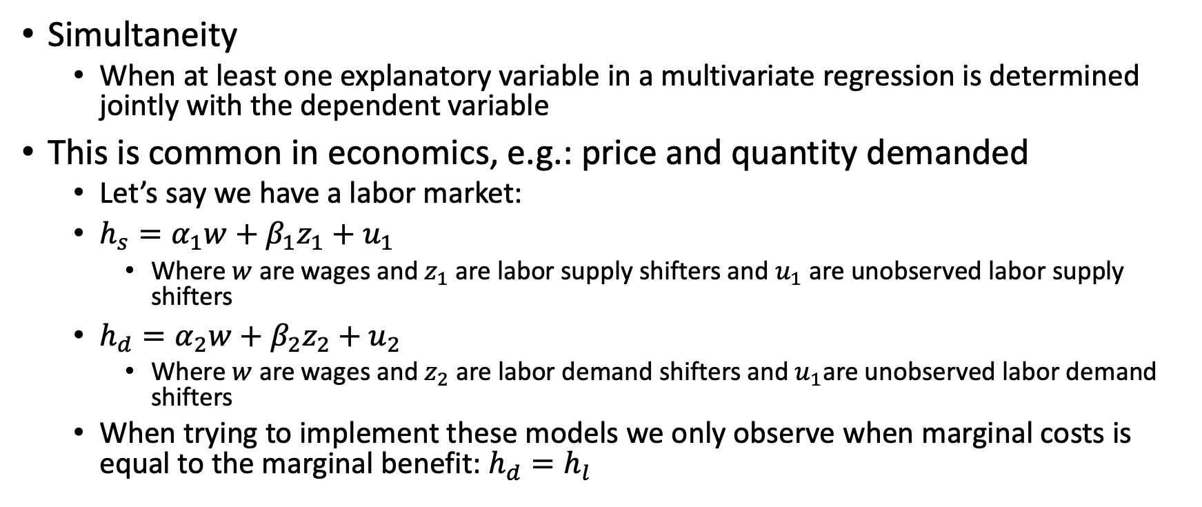
Simultaneity
Simultaneity
When at least one explanatory variable in a multivariate regression is determined jointly with the dependent variable
This is common in economics, e.g.: price and quantity demanded
Let’s say we have a labor market:
$h_{s}=α_{1}w+β_{1}z_{1}+u_{1}$
Where $w$ are wages and $z_{1}$ are labor supply shifters and $u_{1}$ are unobserved labor supply shifters
$h_{d}=α_{2}w+β_{2}z_{2}+u_{2}$
Where $w$ are wages and $z_{2}$ are labor demand shifters and $u_{1}$are unobserved labor demand shifters
When trying to implement these models we only observe when marginal costs is equal to the marginal benefit: $h_{d}=h_{l}$

Slide 68
Simultaneity
Simultaneity bias
When we use the OLS estimator to estimate the parameters, a bias occurs since the covariance of the endogenous variable and the error term is not zero
Using an OLS estimator will result be biased and inconsistent
This leads to an identification problem
How do we identify the unbiased parameter or causal effect of wages on hours when they are jointly determined?
We’ll cover simultaneity later
What to do?
Instrumental Variables/Two-stage least squares

Slide 69
Biases in Standard Errors of the OLS Estimator

Slide 70
Biases in Standard Errors of the OLS Estimator
Overidentification
Multicollinearity
Heteroskedasticity
Measurement Error in Dependent Variable

Slide 71
Overidentifying
What happens when we include irrelevant variables instead of relevant variables?
It does not affect the unbiasedness
Consequences
It can bias the standard errors and/or make the standard errors of the OLS estimator larger
What to do?
Sensitivity tests

Slide 72
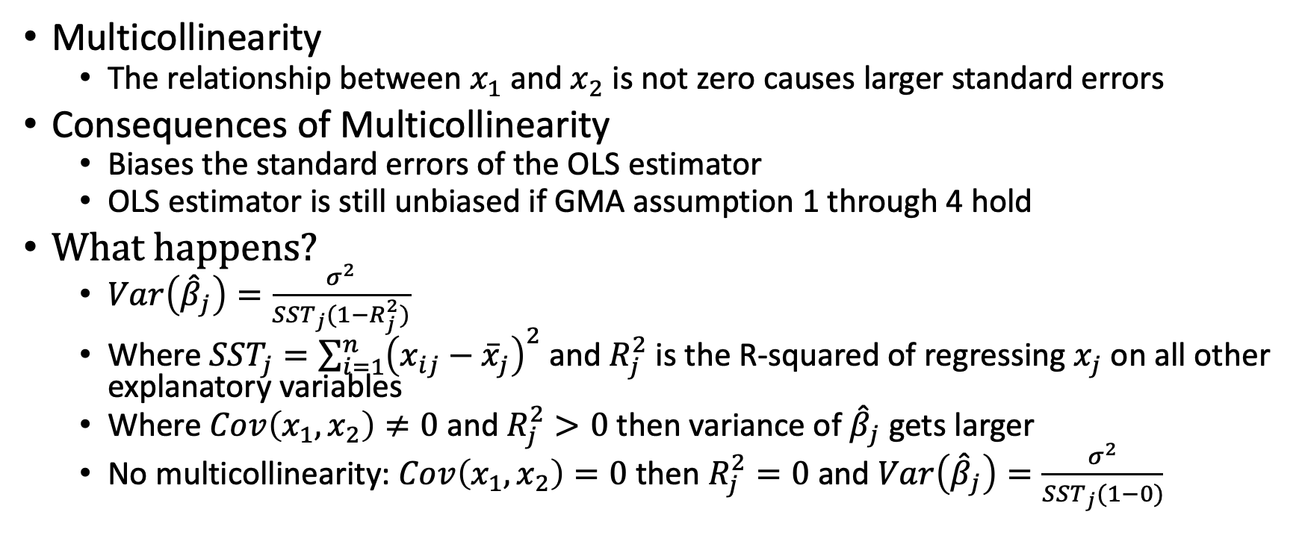
Multicollinearity
Multicollinearity
The relationship between $x_{1}$ and $x_{2}$ is not zero causes larger standard errors
Consequences of Multicollinearity
Biases the standard errors of the OLS estimator
OLS estimator is still unbiased if GMA assumption 1 through 4 hold
What happens?
$Var\left({\hat{β}}_{j}\right)=\frac{σ^{2}}{SST_{j}(1−R_{j}^{2})}$
Where $SST_{j}=\sum_{i=1}^{n}{{\left(x_{ij}−{\overline{x}}_{j}\right)}^{2}}$ and $R_{j}^{2}$ is the R-squared of regressing $x_{j}$ on all other explanatory variables
Where $Cov\left(x_{1},x_{2}\right)≠0$ and $R_{j}^{2}>0$ then variance of ${\hat{β}}_{j}$ gets larger
No multicollinearity: $Cov\left(x_{1},x_{2}\right)=0$ then $R_{j}^{2}=0$ and $Var\left({\hat{β}}_{j}\right)=\frac{σ^{2}}{SST_{j}(1−0)}$

Slide 73
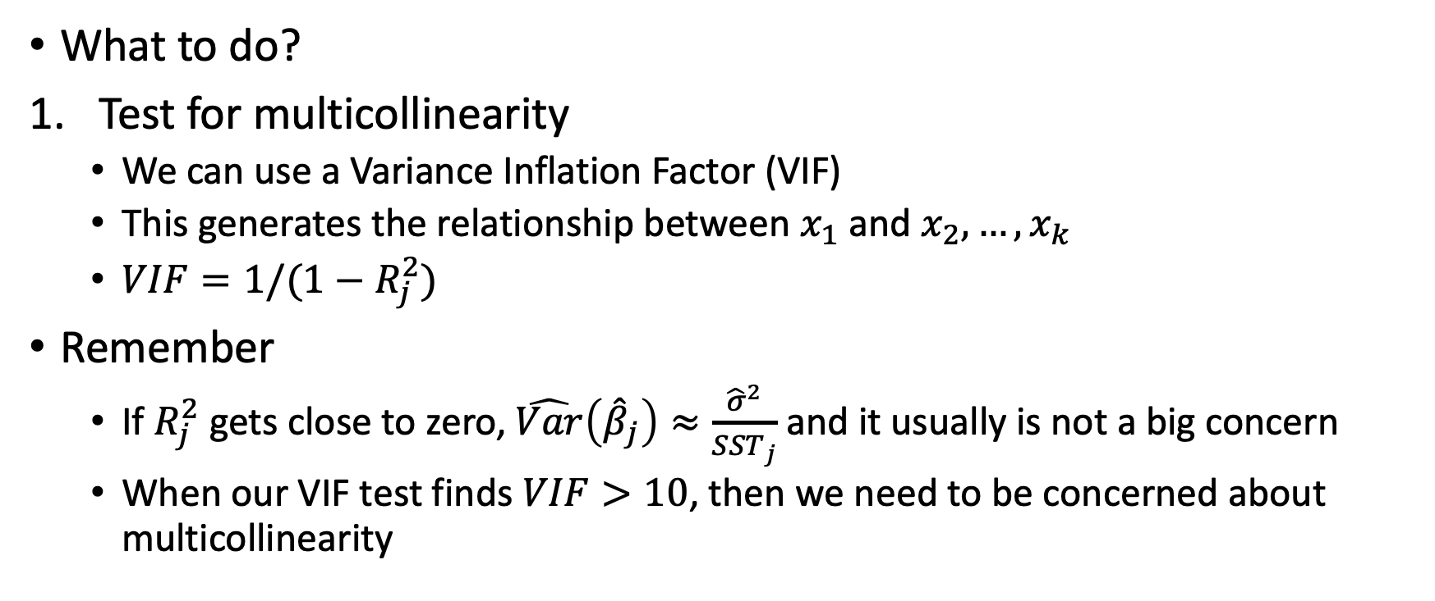
Multicollinearity
What to do?
Test for multicollinearity
We can use a Variance Inflation Factor (VIF)
This generates the relationship between $x_{1}$ and $x_{2}, …, x_{k}$
$VIF=1/(1−R_{j}^{2})$
Remember
If $R_{j}^{2}$ gets close to zero, $\hat{Var}\left({\hat{β}}_{j}\right)≈\frac{{\hat{σ}}^{2}}{SST_{j}}$ and it usually is not a big concern
When our VIF test finds $VIF>10$, then we need to be concerned about multicollinearity

Slide 74
Heteroskedasticity

Slide 75
Heteroskedasticity
Heteroskedasticity
When the variance of the OLS estimator is not constant along the variance-covariance matrix
This is a violation of the fifth Gauss-Markov assumption
The OLS estimator can still be unbiased with the presence of heteroskedasticity
Consequences of heteroskedasticity
Biased standard errors of the OLS estimator

Slide 76
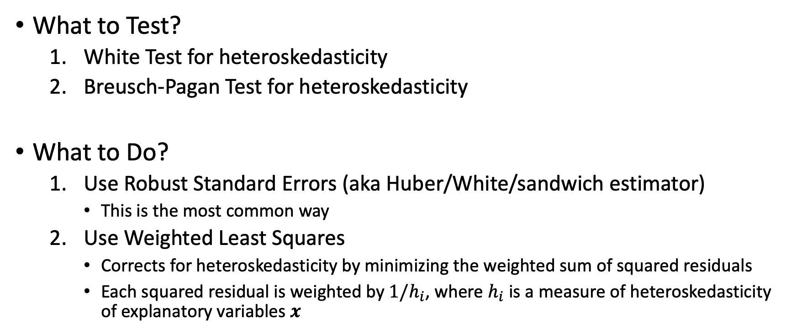
Heteroskedasticity
What to Test?
White Test for heteroskedasticity
Breusch-Pagan Test for heteroskedasticity
What to Do?
Use Robust Standard Errors (aka Huber/White/sandwich estimator)
This is the most common way
Use Weighted Least Squares
Corrects for heteroskedasticity by minimizing the weighted sum of squared residuals
Each squared residual is weighted by $1/h_{i}$, where $h_{i}$ is a measure of heteroskedasticity of explanatory variables $x$

Slide 77
Review

Slide 78
Review
Biased coefficients
Misspecification
Endogeneity
Omitted Variable Bias
Measurement Error
Nonrandom Missing Data or sample selection
Simultaneity
Biased standard errors of coefficients
Multicollinearity and Heteroskedasticity
Measurement Error in the Dependent Variable

